Slide 1
Documentation & Variadic
resources, help, variadic, BNF, documentation

Slide 2
Preview
getting help
go help
go help [command]
go help [topic]
go help examples:
go help env
variadic
...
BNF / EBNF
Backus Naur Form
Extended Backus Naur Form
go help packages
go help build
go help install
documentation
godoc.org
“imported by” example code
golang.org
godoc
google: golang godoc
golang.org/x/tools/cmd/godoc
godoc -src fmt Println
godoc -src fmt
godoc -http=:6060
godoc -html fmt
godoc -html fmt Println
godoc -q Reader
godoc -q Writer
godoc -q rand
close server
ctrl + c
http://go-search.org/
resources
An Introduction to Programming in Go
Bootcamp training
go by example
pluralsight trainings
youtube todd mcleod playlists
Golang.org
A Tour of Go
Golang Newsletter
Some other training I’ve yet to take
Go Wiki
learning golang from golang.org
http://golang.org/doc/
https://golang.org/doc/install
https://golang.org/ref/spec
https://tour.golang.org/welcome/1
https://golang.org/doc/code.html
https://golang.org/doc/effective_go.html
https://blog.golang.org/

Slide 3
resources

Slide 4
syllabus
https://goo.gl/DE5QsL

Slide 5
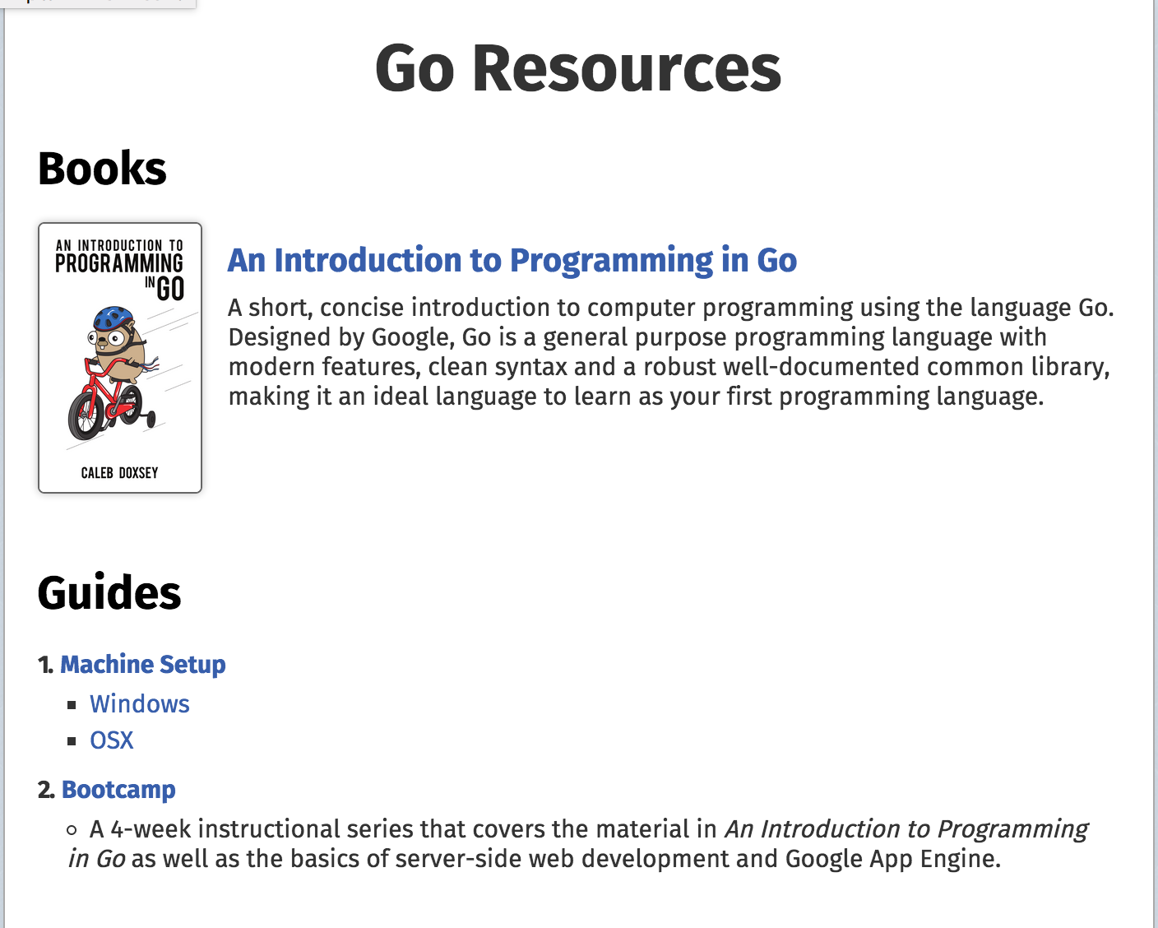
https://www.golang-book.com/

Slide 6
Summer Web Bootcamp Outline
Bootcamp Videos
one listing & another listing of same videos
Summer Web Bootcamp Code

Slide 7
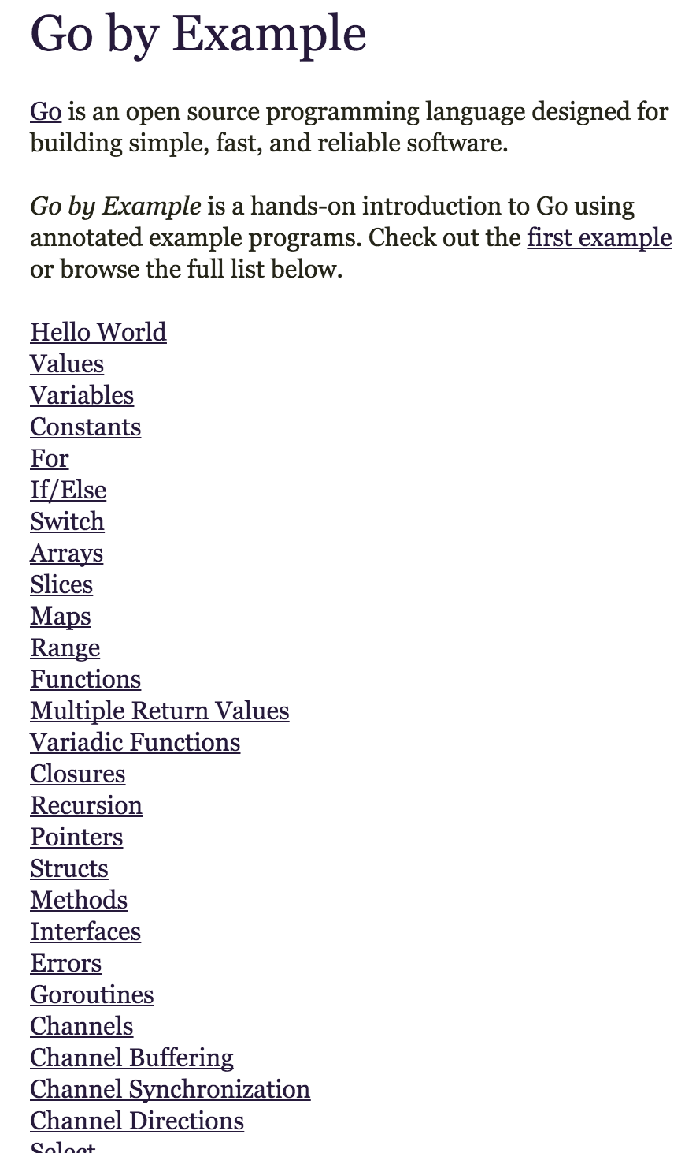
https://gobyexample.com/

Slide 8

https://www.manning.com/books/go-in-action
Notes:
44% off (goiaucf)

Slide 9

https://github.com/ArdanStudios/gotraining

Slide 10
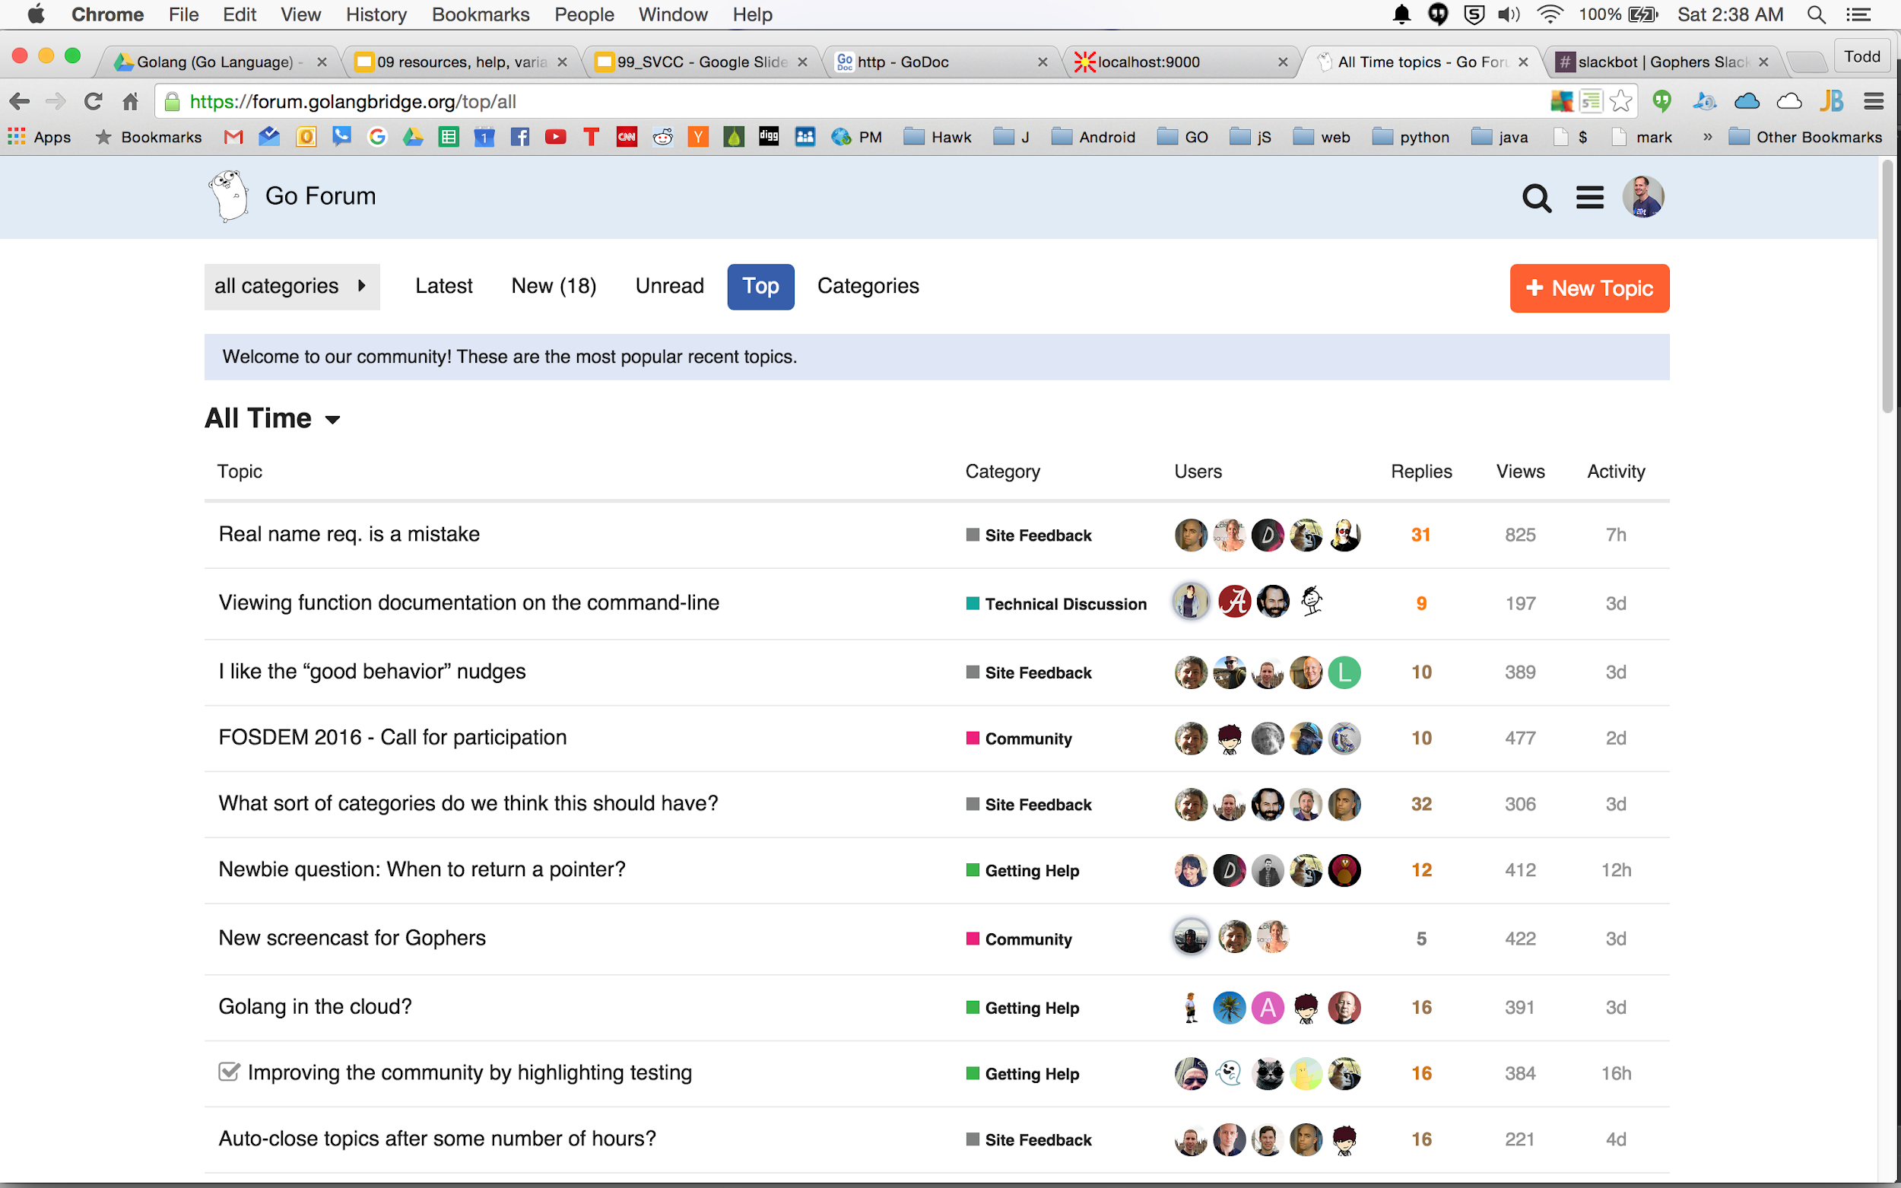

Slide 11
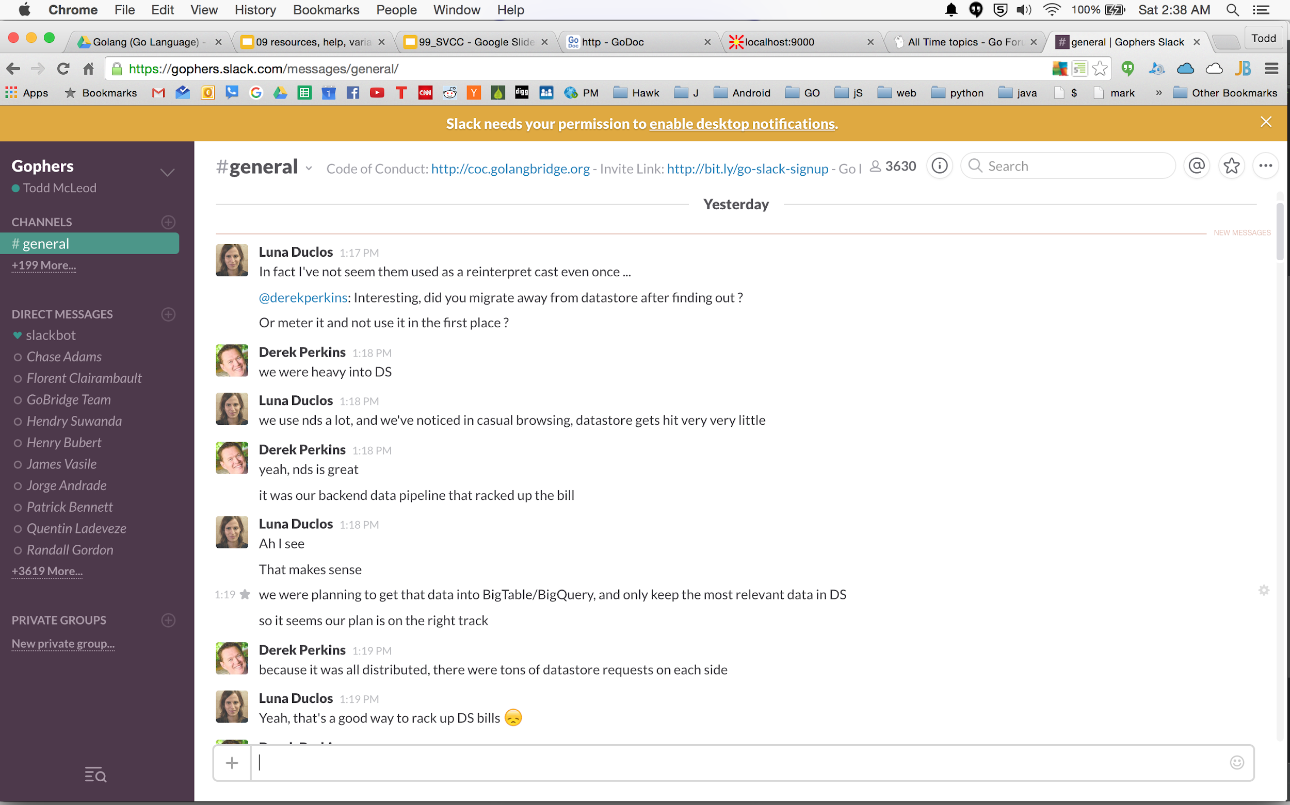

Slide 12
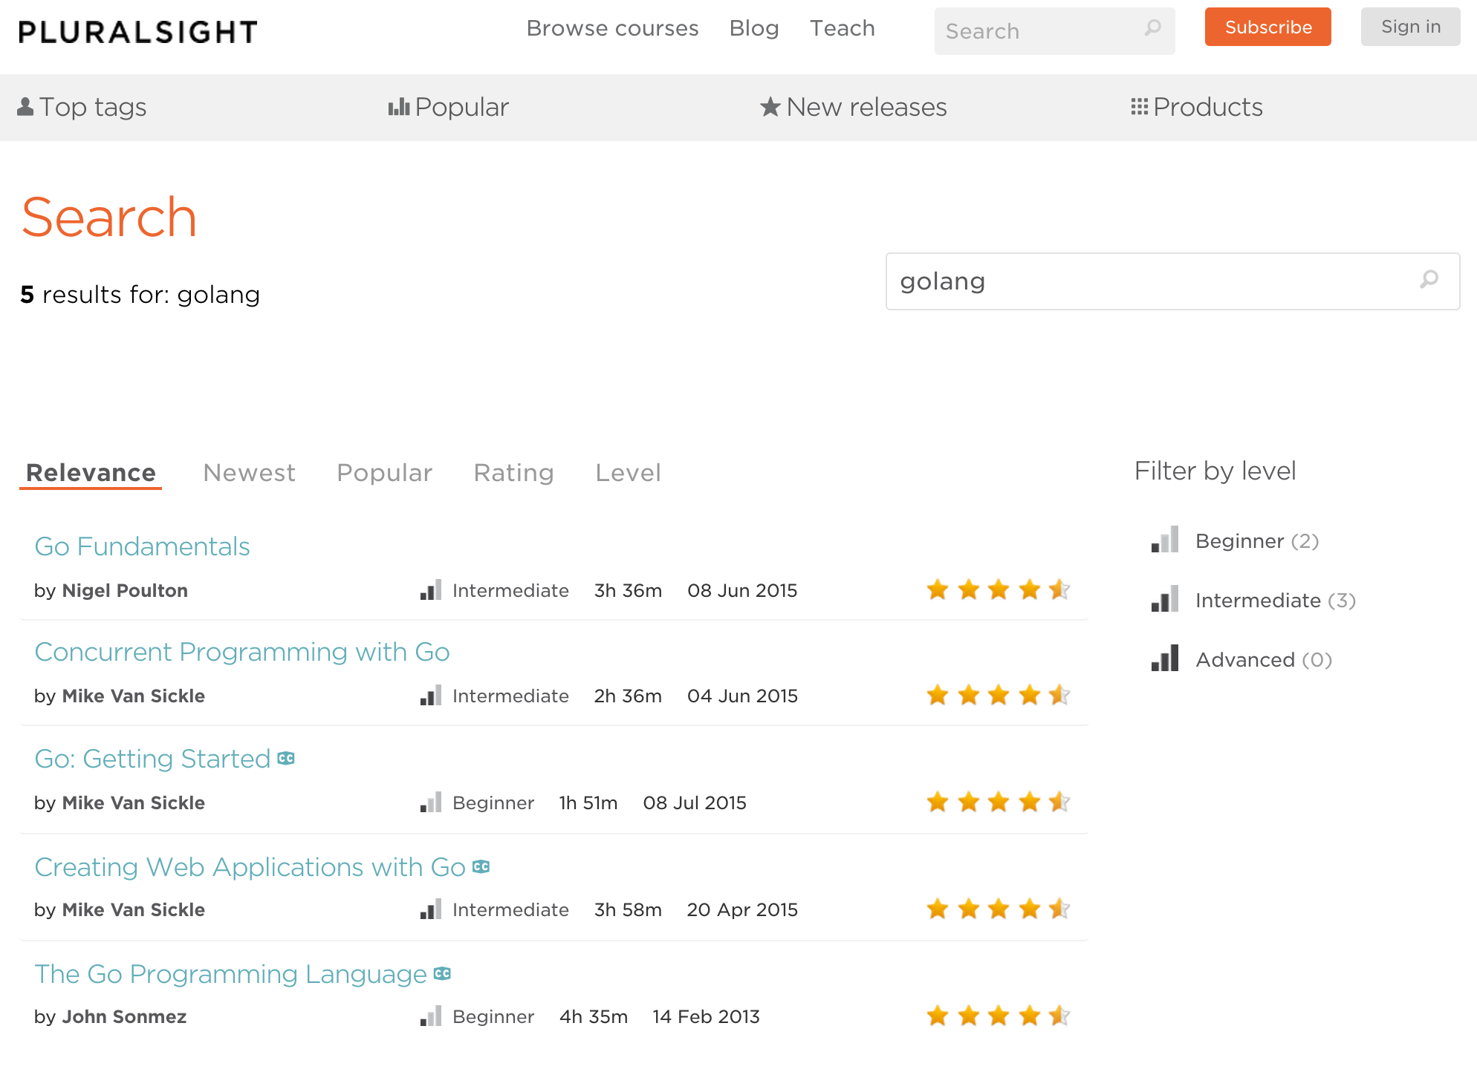
http://www.pluralsight.com/search/?searchTerm=golang

Slide 13
https://leanpub.com/howdoibuildawebappwithgo

Slide 14
https://www.gitbook.com/book/codegangsta/building-web-apps-with-go/details

Slide 15
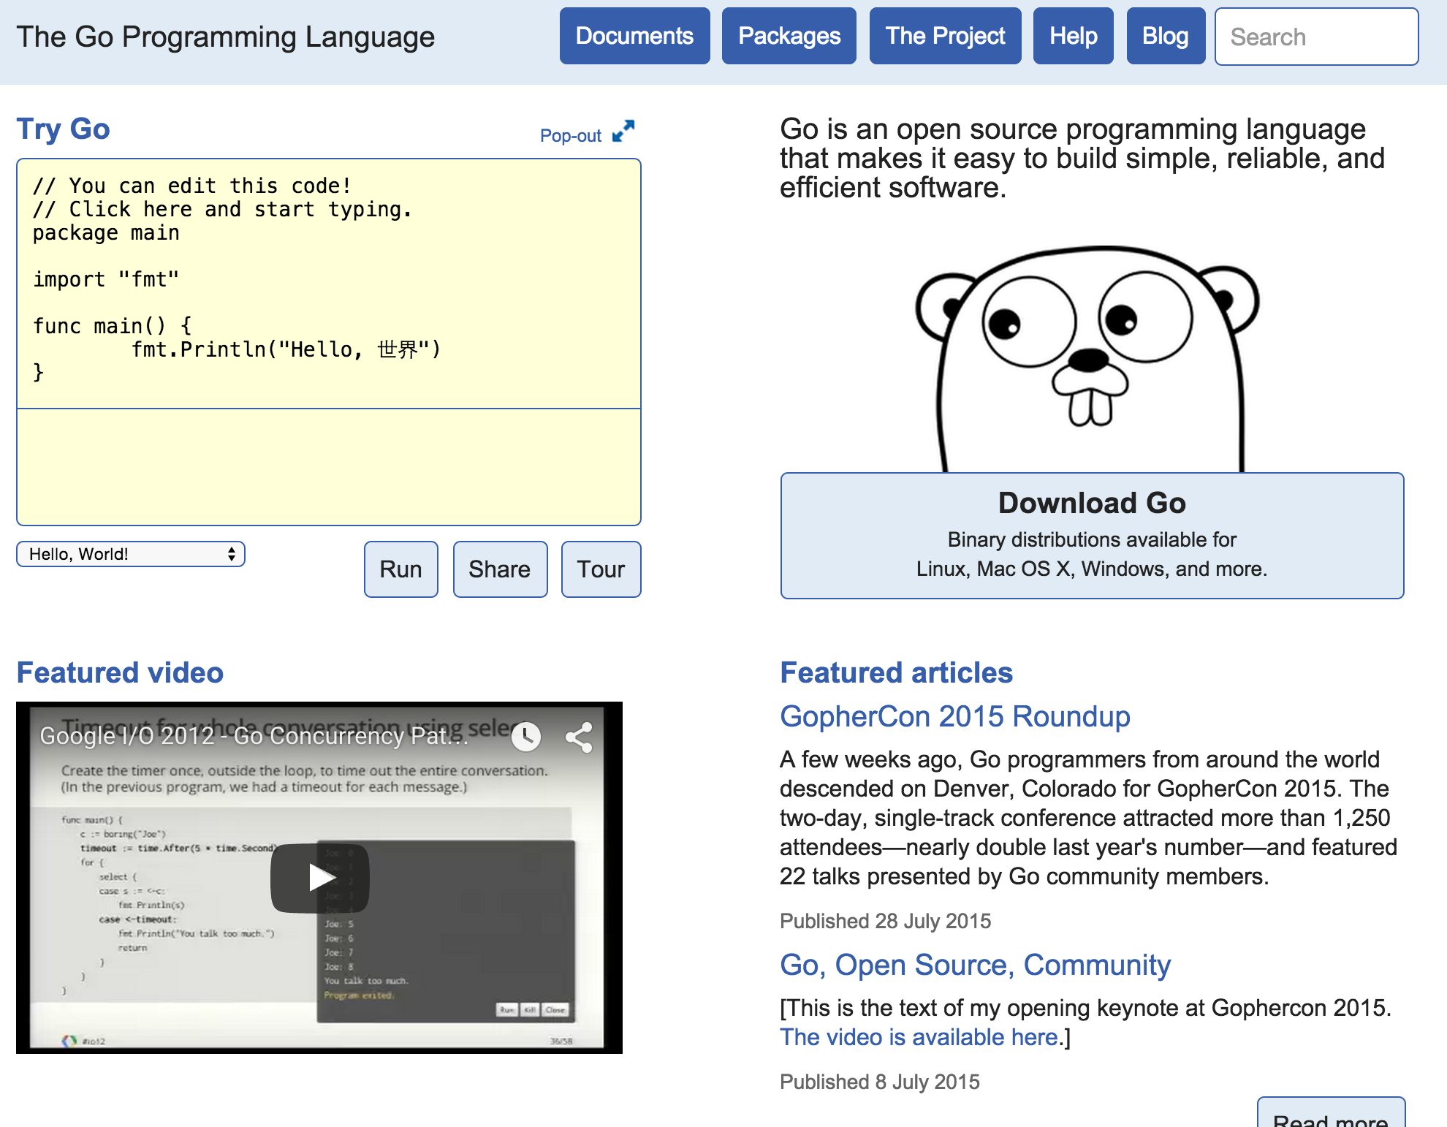
https://golang.org/

Slide 16
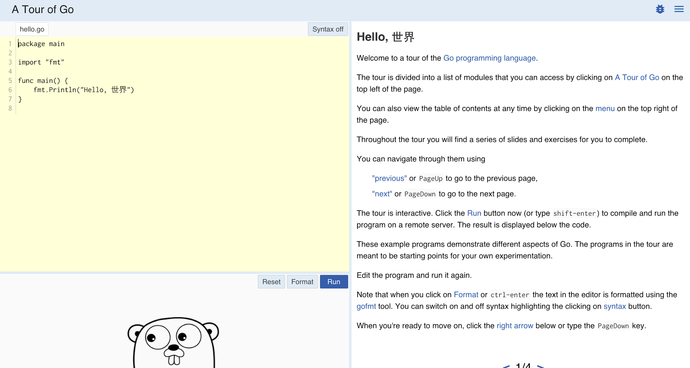
https://tour.golang.org/welcome/1

Slide 17

http://golangweekly.com/

Slide 18
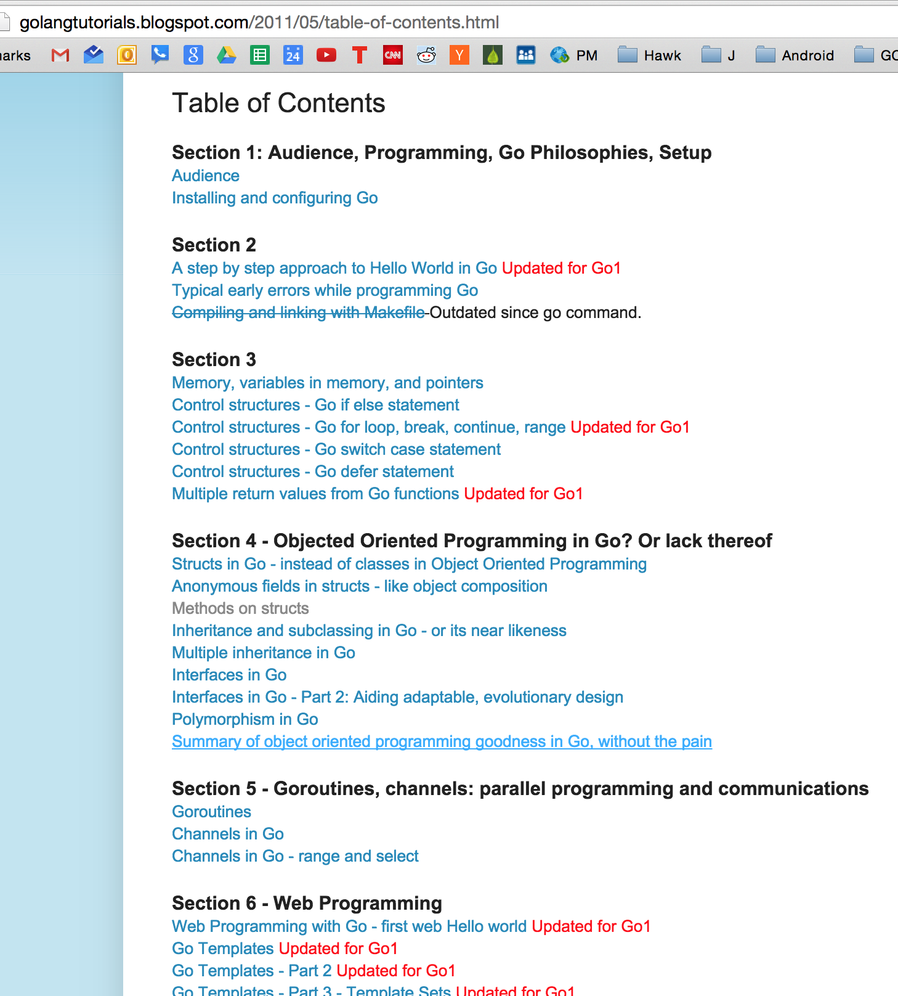
I haven’t checked this out, yet.
It looks promising, though.
Let me know if it’s any good.
http://golangtutorials.blogspot.com/2011/05/table-of-contents.html

Slide 19
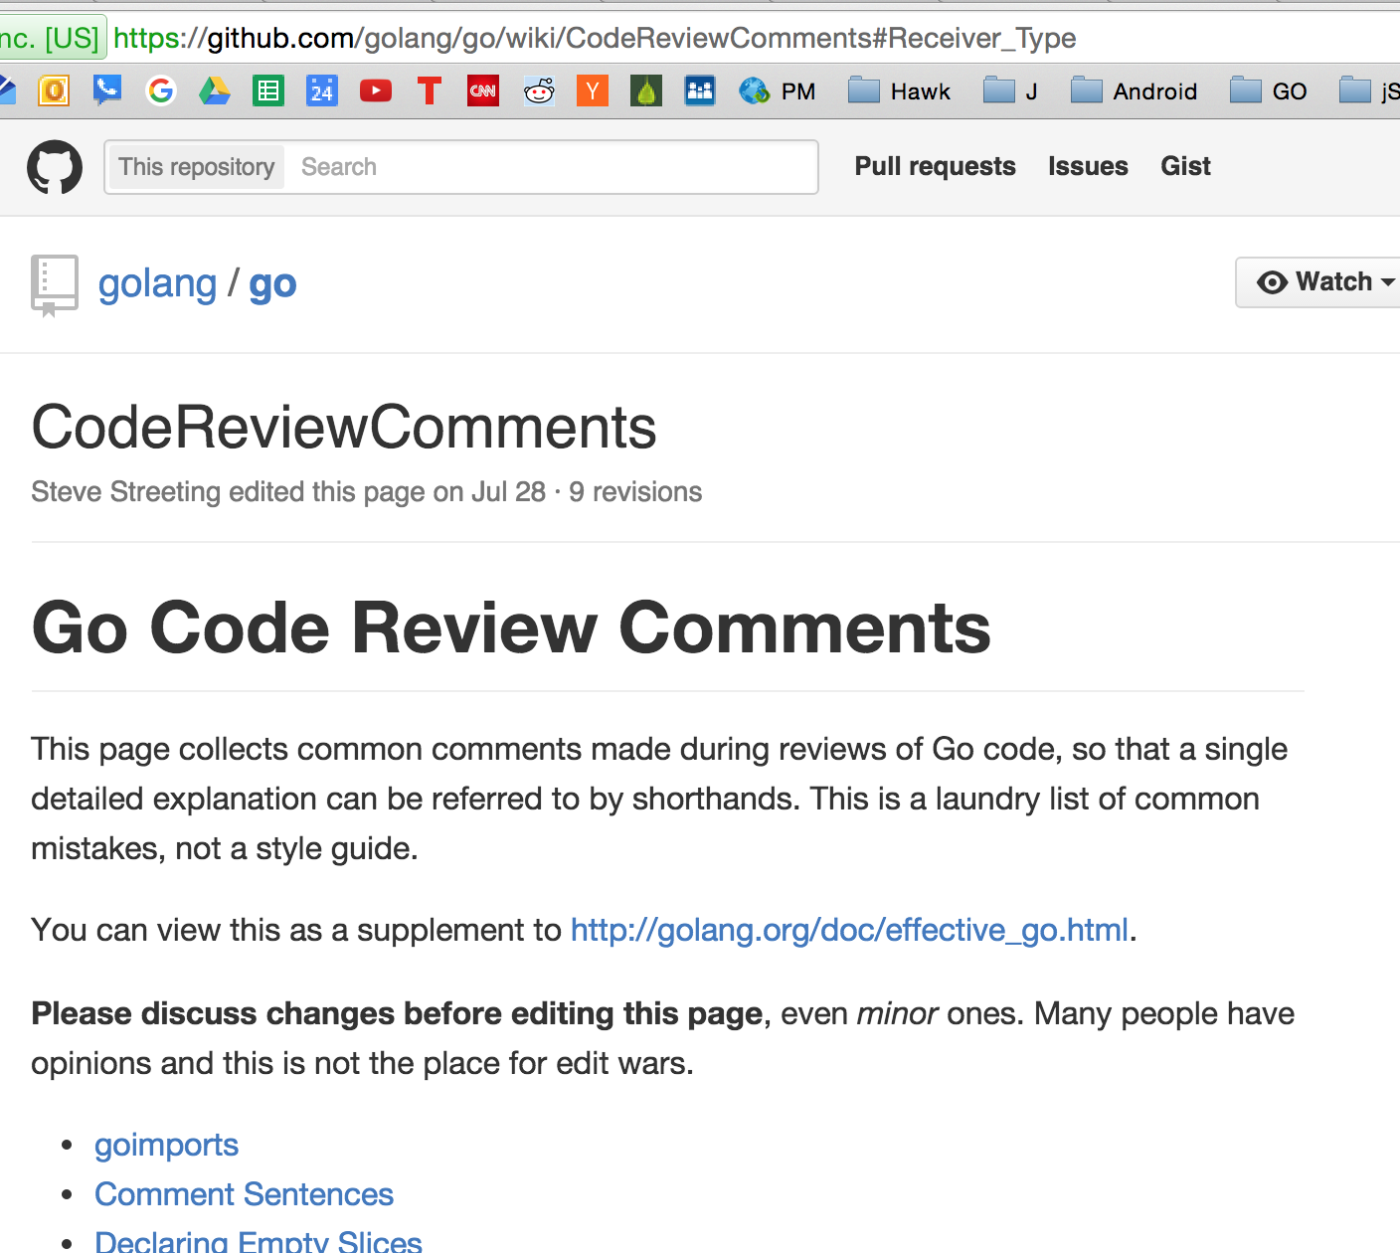
go wiki

Slide 20
learning golang
from golang.org

Slide 21
Preview
getting help
go help
go help [command]
go help [topic]
go help examples:
go help env
variadic
...
BNF / EBNF
Backus Naur Form
Extended Backus Naur Form
go help packages
go help build
go help install
documentation
godoc.org
“imported by” example code
golang.org
godoc
google: golang godoc
golang.org/x/tools/cmd/godoc
godoc -src fmt Println
godoc -src fmt
godoc -http=:6060
godoc -html fmt
godoc -html fmt Println
godoc -q Reader
godoc -q Writer
godoc -q rand
close server
ctrl + c
http://go-search.org/
resources
An Introduction to Programming in Go
Bootcamp training
go by example
pluralsight trainings
youtube todd mcleod playlists
Golang.org
A Tour of Go
Golang Newsletter
Some other training I’ve yet to take
Go Wiki
learning golang from golang.org
http://golang.org/doc/
https://golang.org/doc/install
https://golang.org/ref/spec
https://tour.golang.org/welcome/1
https://golang.org/doc/code.html
https://golang.org/doc/effective_go.html
https://blog.golang.org/

Slide 22
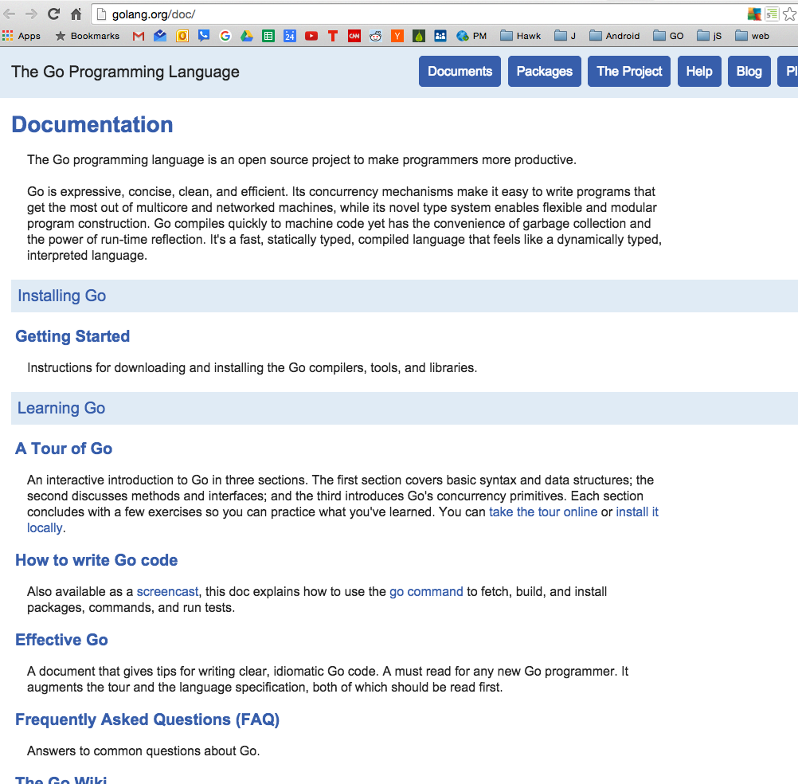

Slide 23
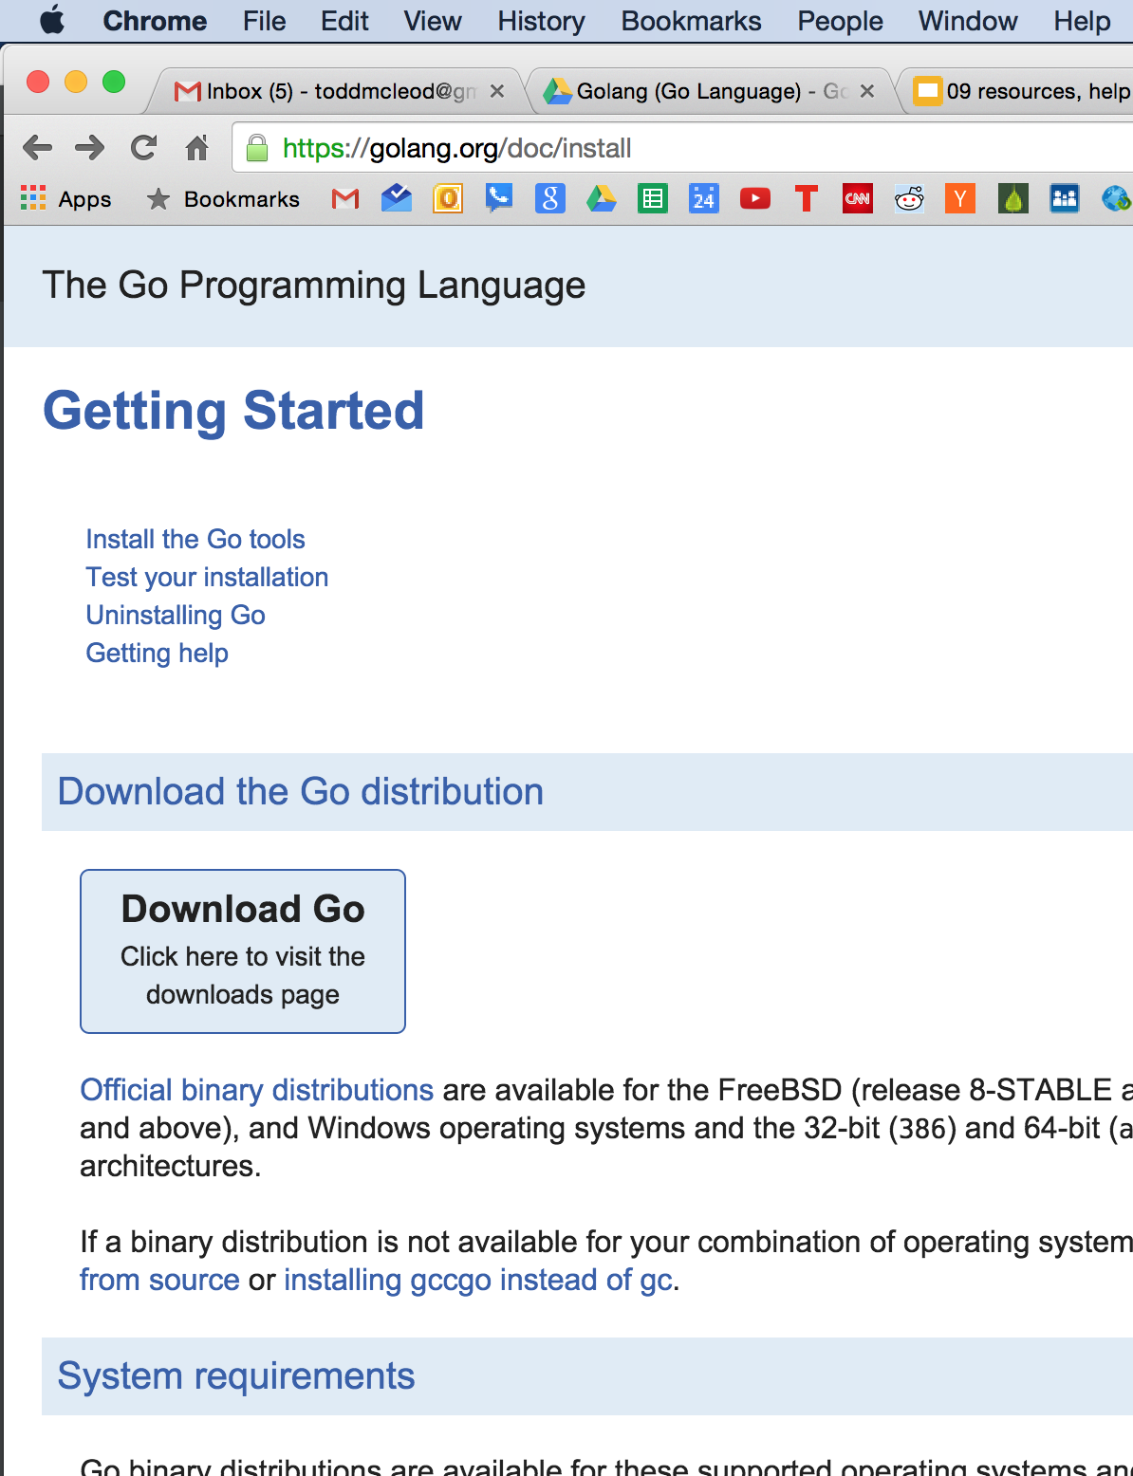
install

Slide 24
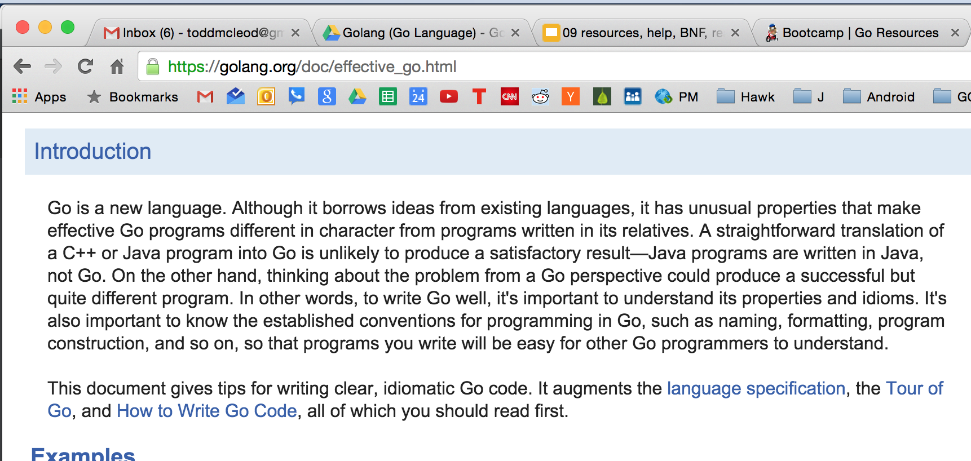
effective go
but not just yet ...

Slide 25
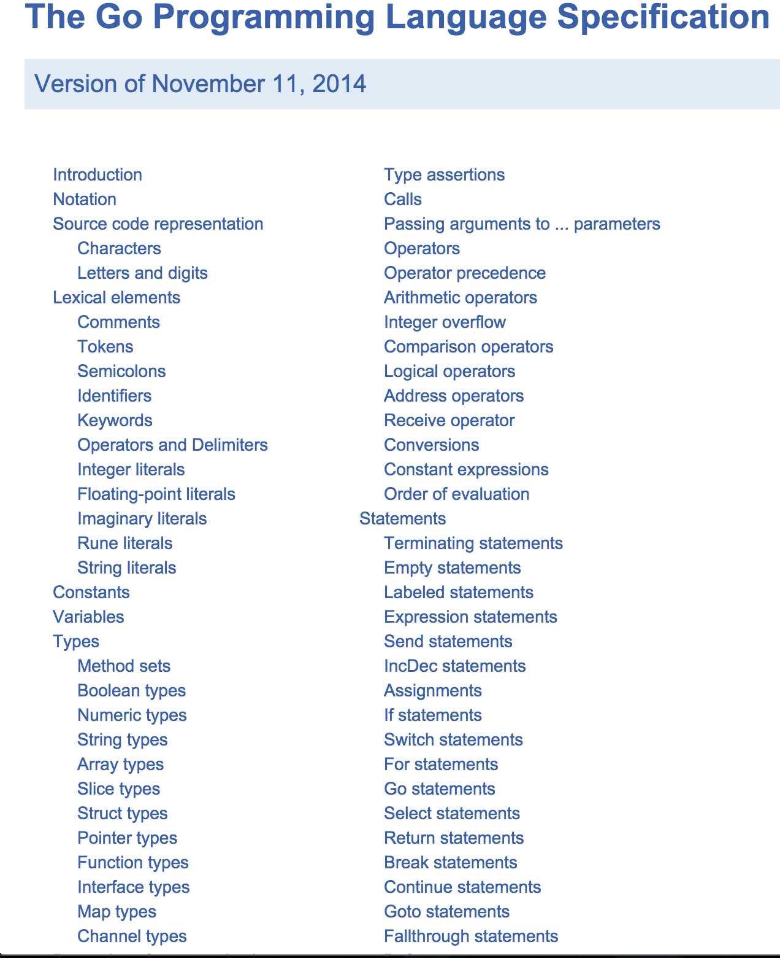
language spec

Slide 26
tour of go
we already saw this

Slide 27
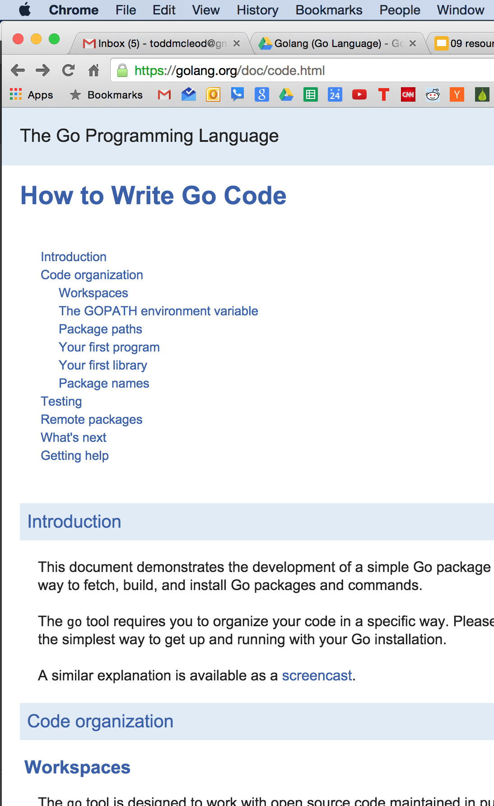
how to write go code

Slide 28
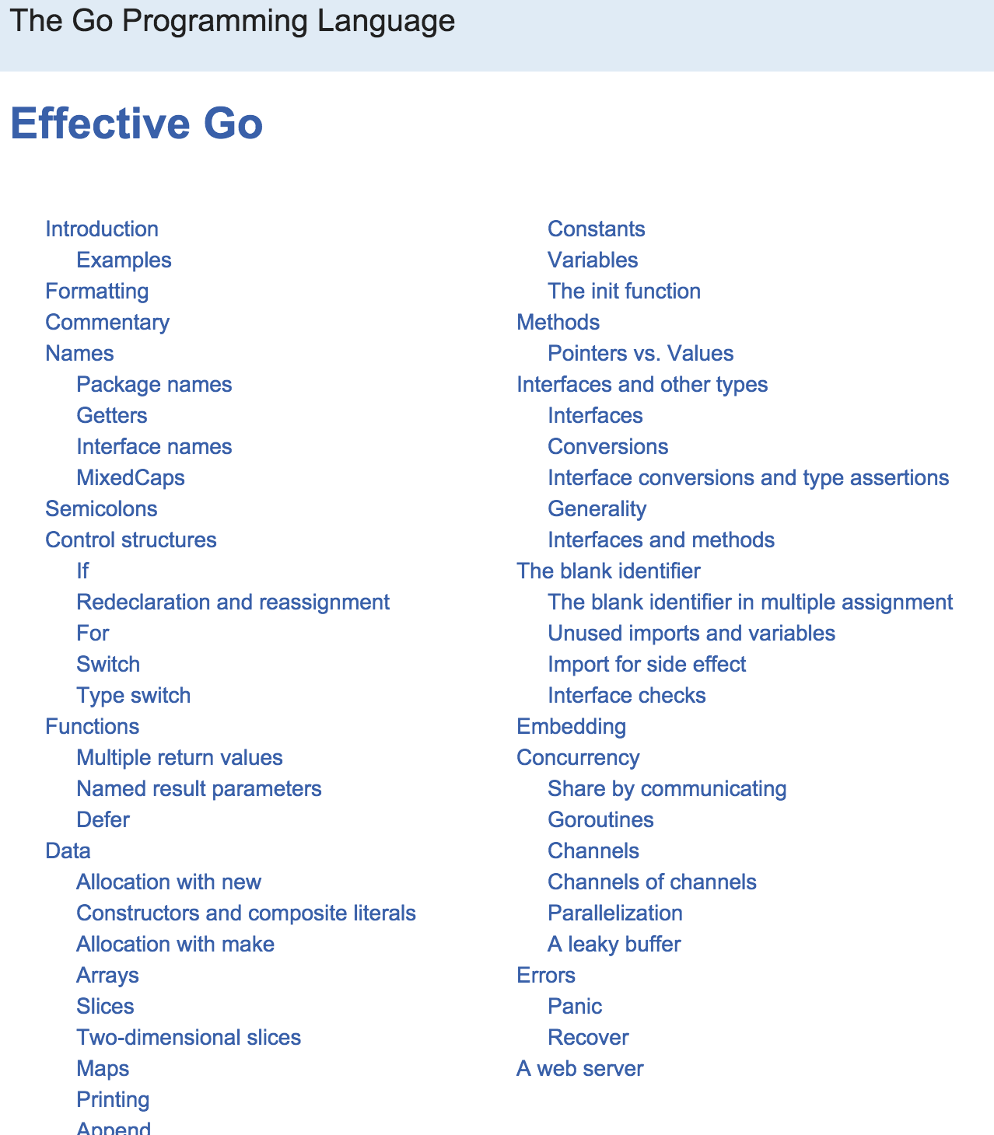
Now …
effective go
https://golang.org/doc/effective_go.html

Slide 29
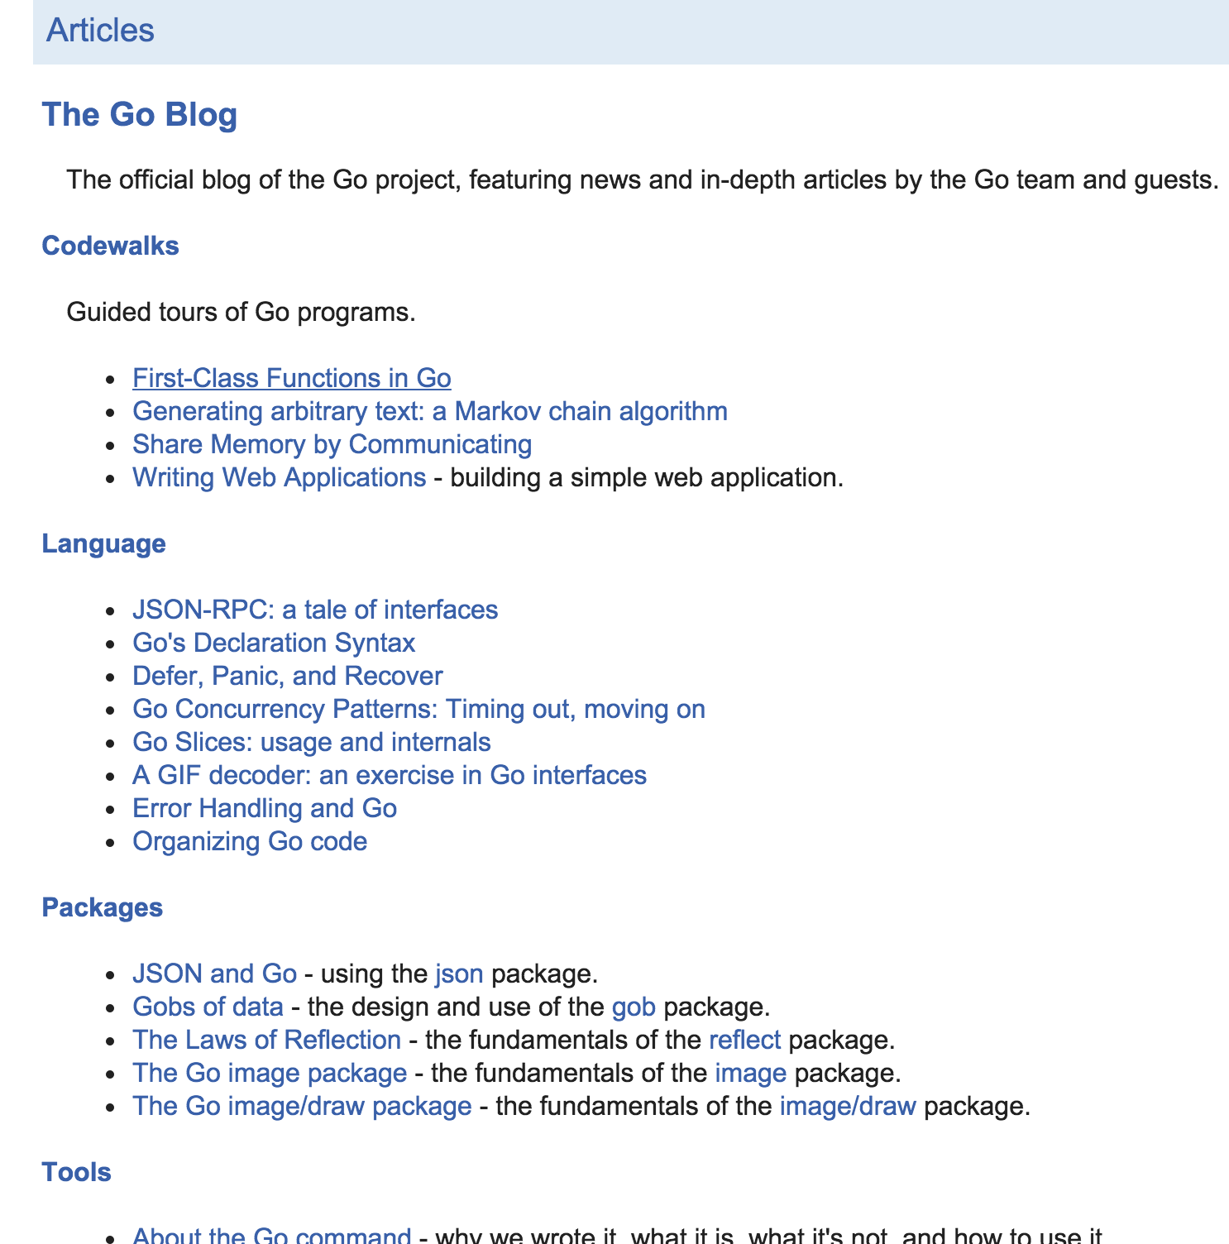
the go blog
https://golang.org/doc/#articles

Slide 30
getting help

Slide 31
Review
Preview
getting help
go help
go help [command]
go help [topic]
go help examples:
go help env
variadic
...
BNF / EBNF
Backus Naur Form
Extended Backus Naur Form
go help packages
go help build
go help install
documentation
godoc.org
“imported by” example code
golang.org
godoc
google: golang godoc
golang.org/x/tools/cmd/godoc
godoc -src fmt Println
godoc -src fmt
godoc -http=:6060
godoc -html fmt
godoc -html fmt Println
godoc -q Reader
godoc -q Writer
godoc -q rand
close server
ctrl + c
http://go-search.org/
resources
An Introduction to Programming in Go
Bootcamp training
go by example
pluralsight trainings
youtube todd mcleod playlists
Golang.org
A Tour of Go
Golang Newsletter
Some other training I’ve yet to take
Go Wiki
learning golang from golang.org
http://golang.org/doc/
https://golang.org/doc/install
https://golang.org/ref/spec
https://tour.golang.org/welcome/1
https://golang.org/doc/code.html
https://golang.org/doc/effective_go.html
https://blog.golang.org/

Slide 32
go help
review

Slide 33
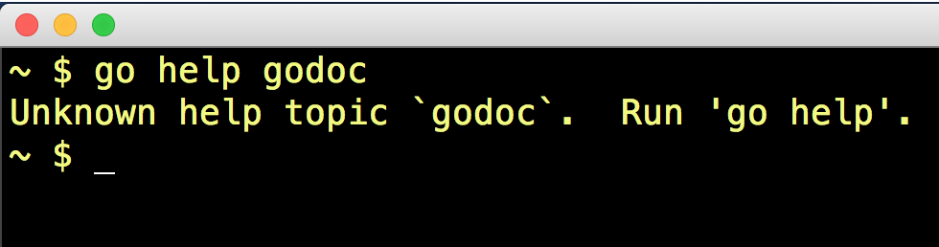
Why doesn’t this work?

Slide 34
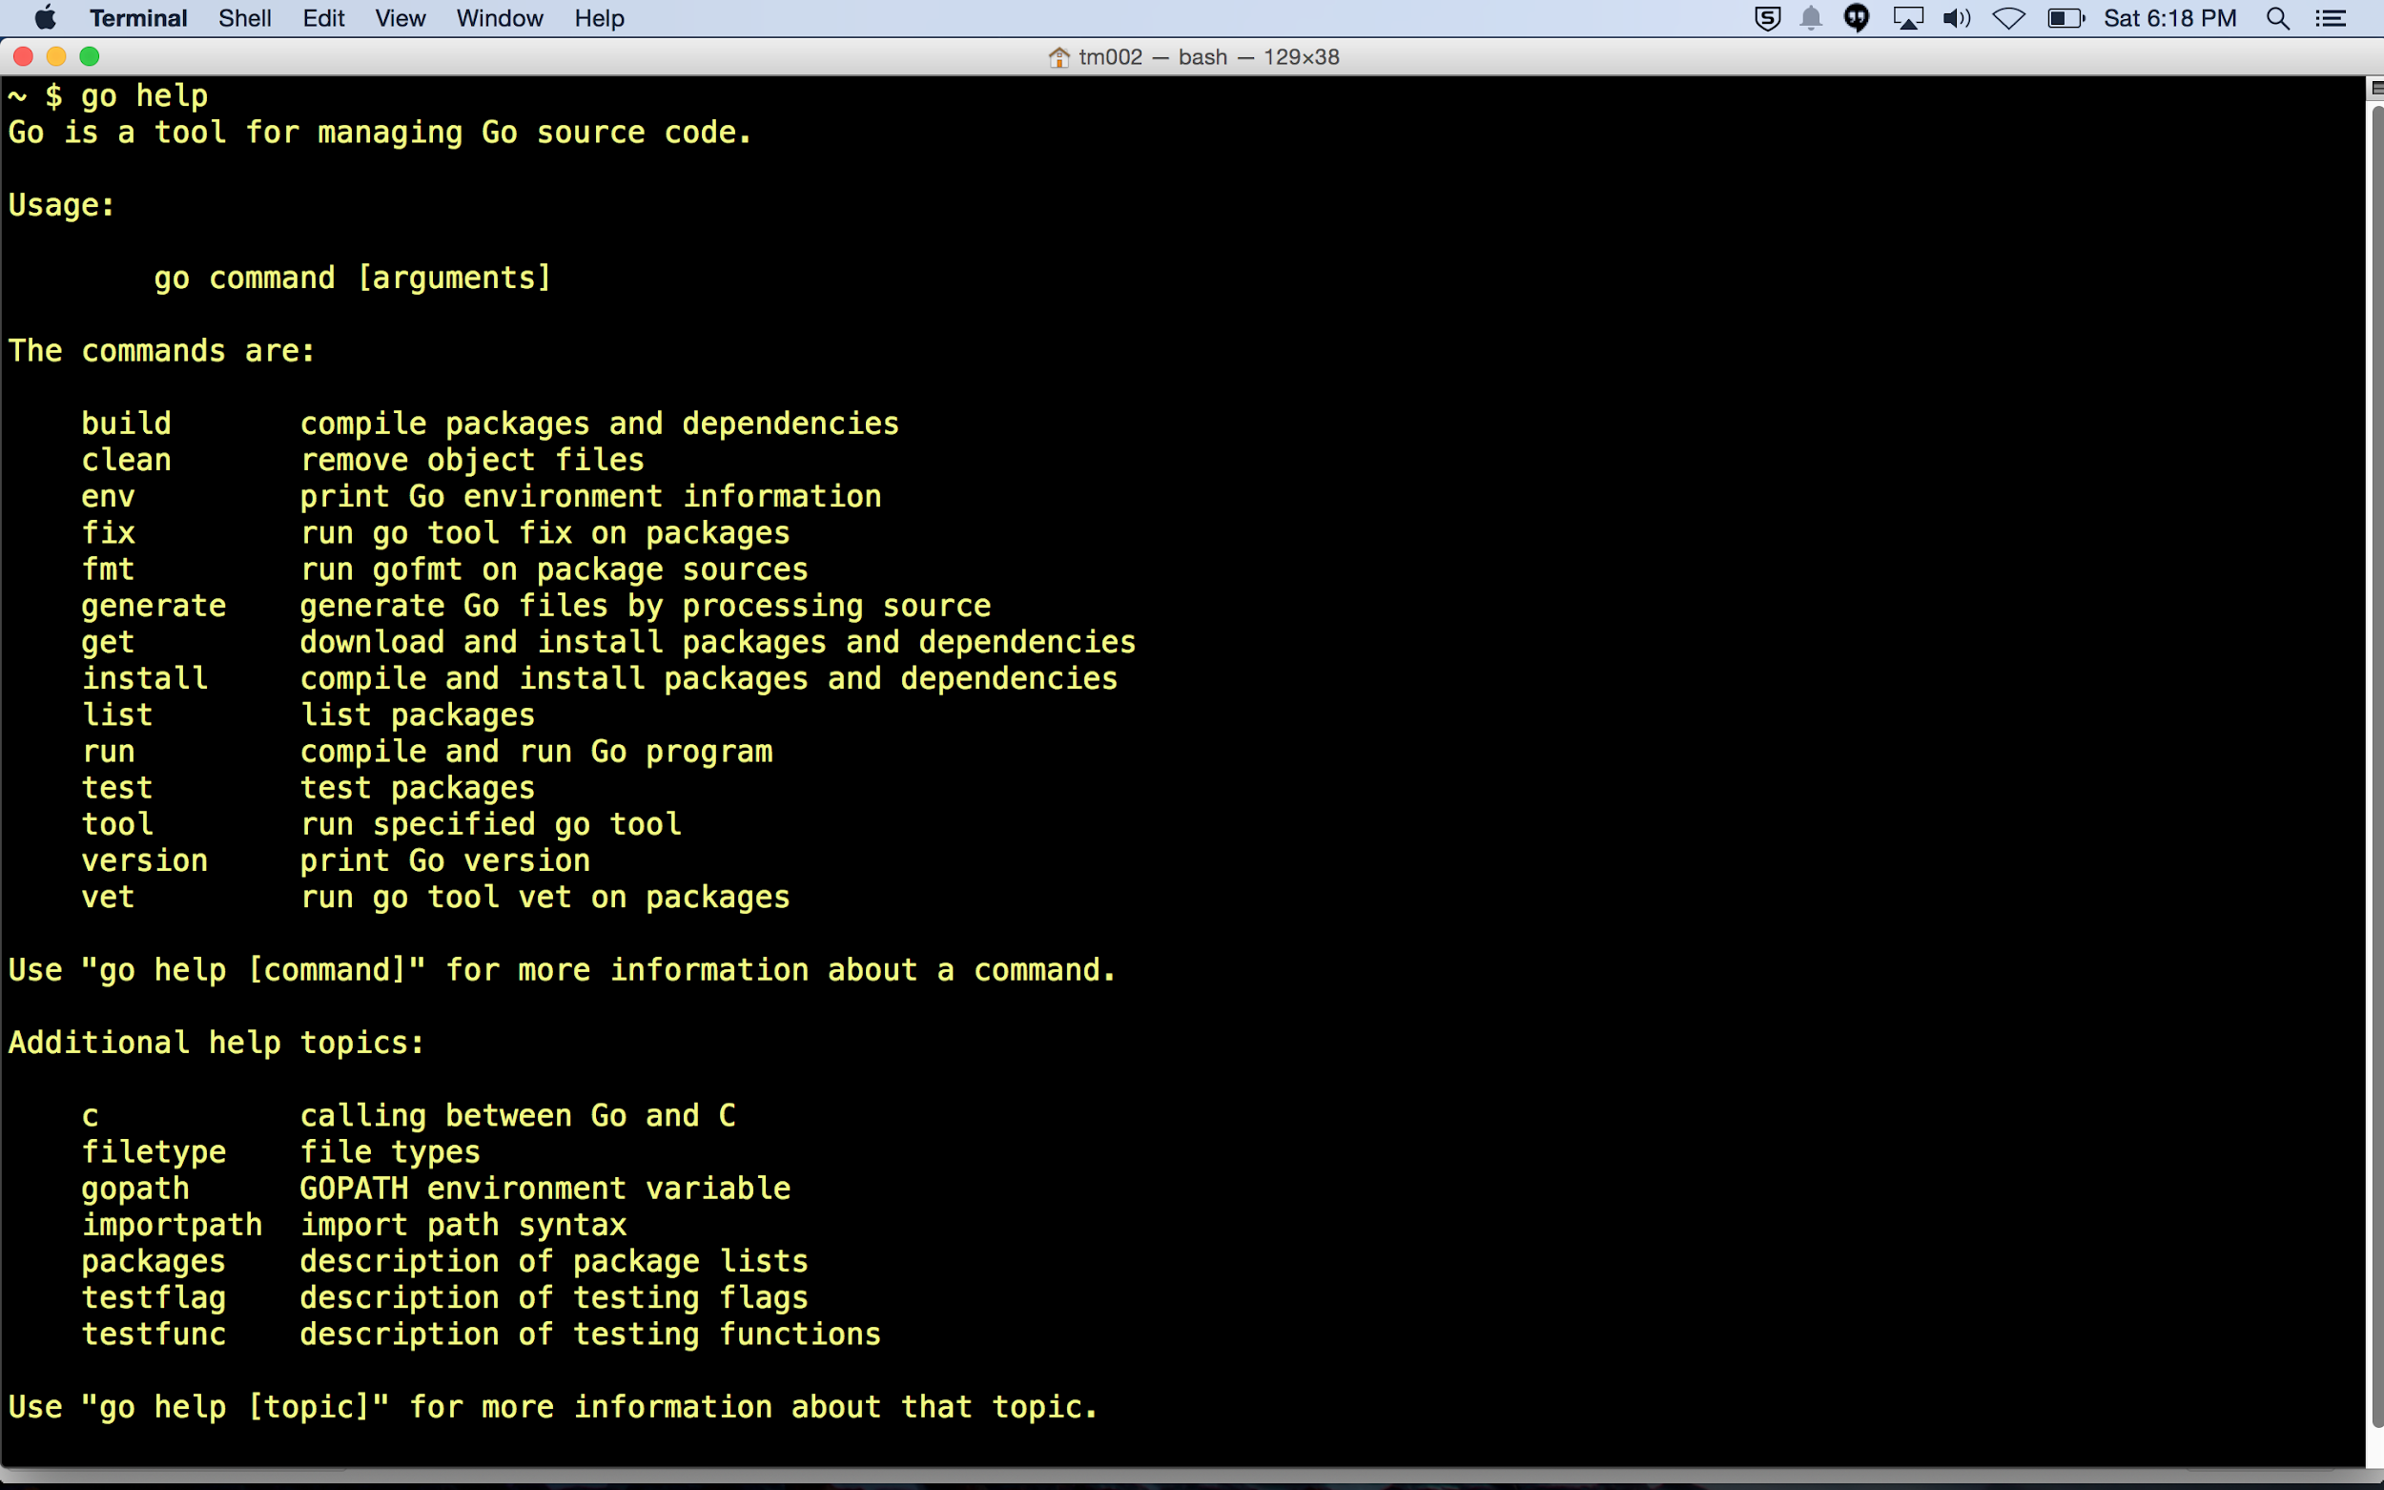
go help [command]
go help [topic]
We already saw this in “01 Getting Started”

Slide 35
review
use “go help [command]” at the terminal
to learn more about the env command

Slide 36
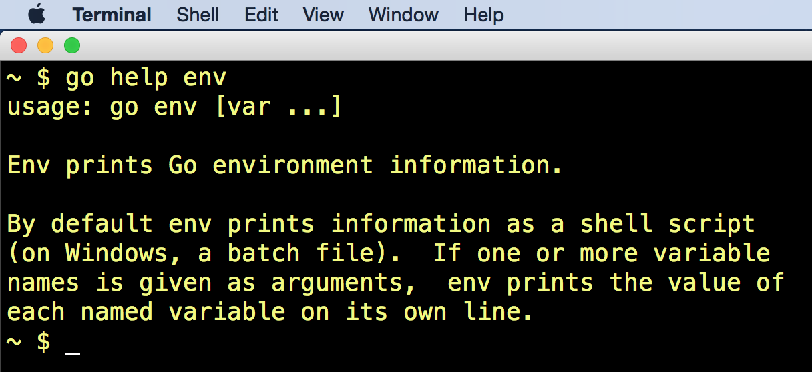

Slide 37
What does this mean?
Go Variadic

Slide 38
To understand what this means
We need to understand both BNF & variadic
Go Variadic

Slide 39
bnf
Backus-Naur Form

Slide 40
Backus Naur Form
Udacity Grammar
Udacity BNF
and on udacity:
grammar
BNF
BNF Quiz
0612 TV BNF
Wikipedia BNF
Wikipedia EBNF

Slide 41
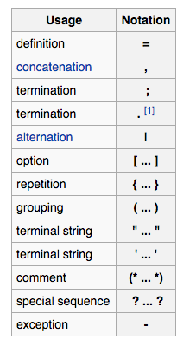
Backus Naur Form
Udacity Grammar
Udacity BNF
and on udacity:
grammar
BNF
BNF Quiz
0612 TV BNF
Wikipedia BNF
Wikipedia EBNF

Slide 42
variadic
...params
args...
Go Variadic

Slide 43
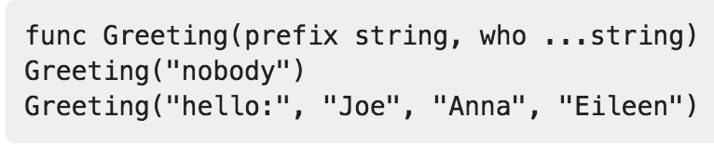
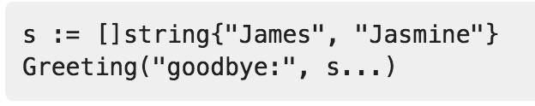
variadic
Multiple parameters
Multiple arguments
Go Variadic

Slide 44
exercise
use “go help [topic]” at the terminal
to learn about packages

Slide 45
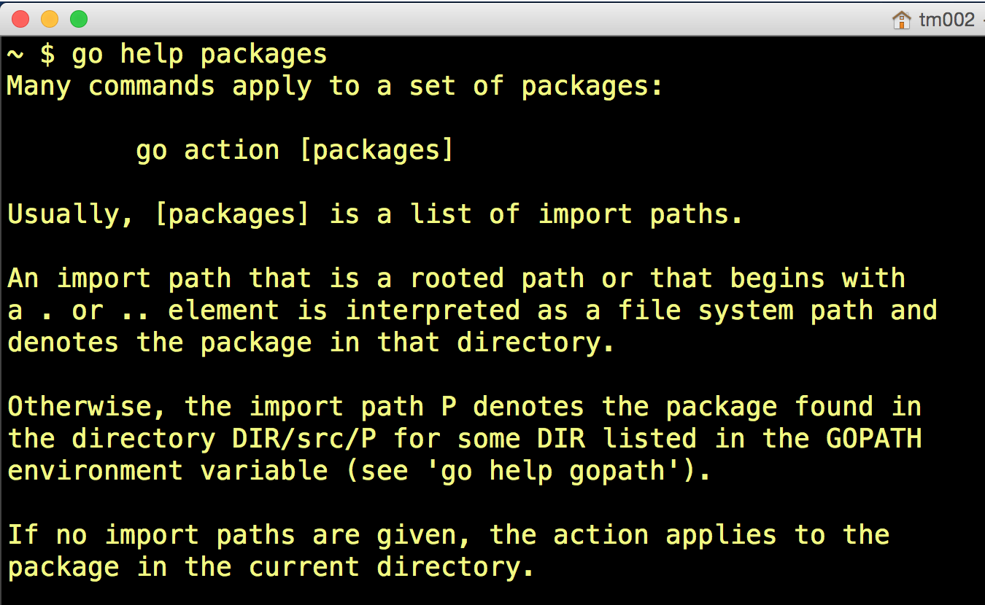

Slide 46
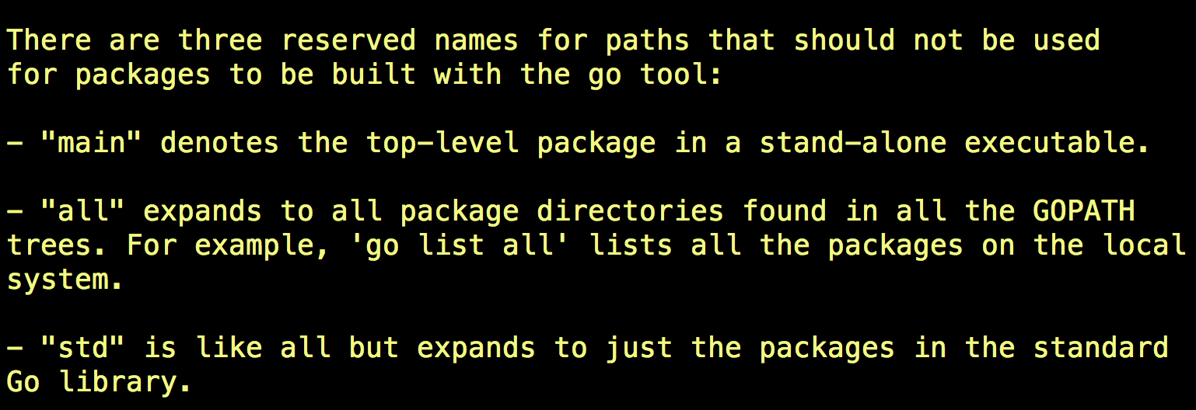

Slide 47
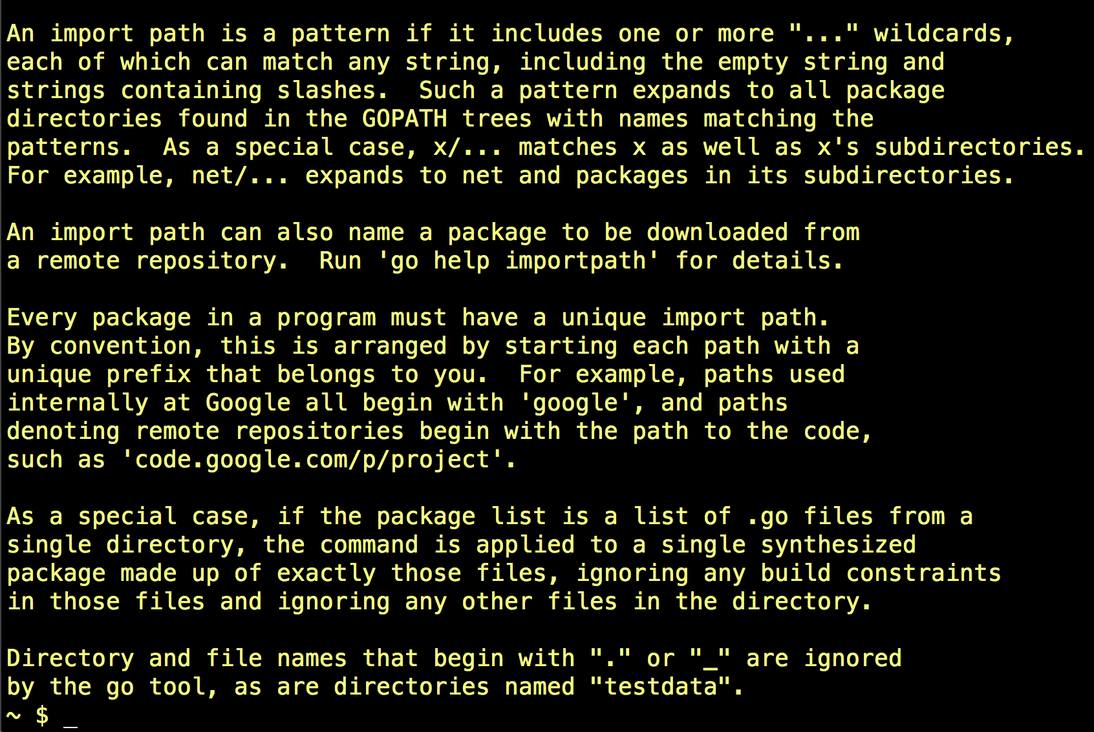

Slide 48
exercise
can you find online
the same information we found
using “go help [topic]” at the terminal
to learn about packages?

Slide 49
exercise
I did not
can you find online
the same information we found
using “go help [topic]” at the terminal
to learn about packages?

Slide 50
exercise
can you find this online?

Slide 51
exercise
can you find this online?
I did not

Slide 52
some information is only available
at the terminal, it seems

Slide 53
finding information sometimes requires
digging around

Slide 54
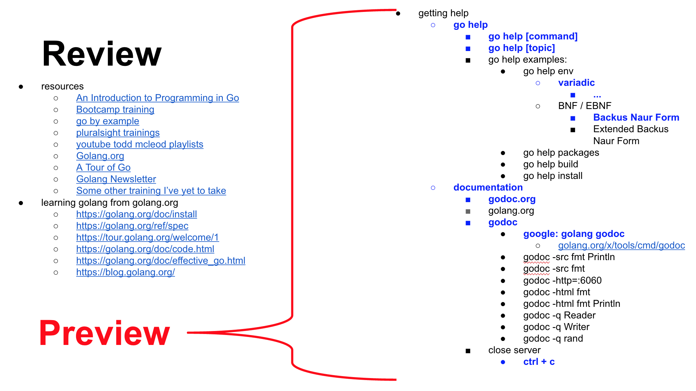
Finding information ...

Slide 55
exercise
use “go help [command]” at the terminal
to learn more about the build command

Slide 56
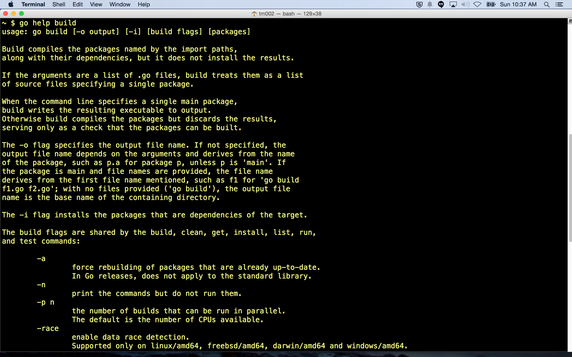

Slide 57
exercise
use “go help [command]” at the terminal
to learn more about the install command

Slide 58
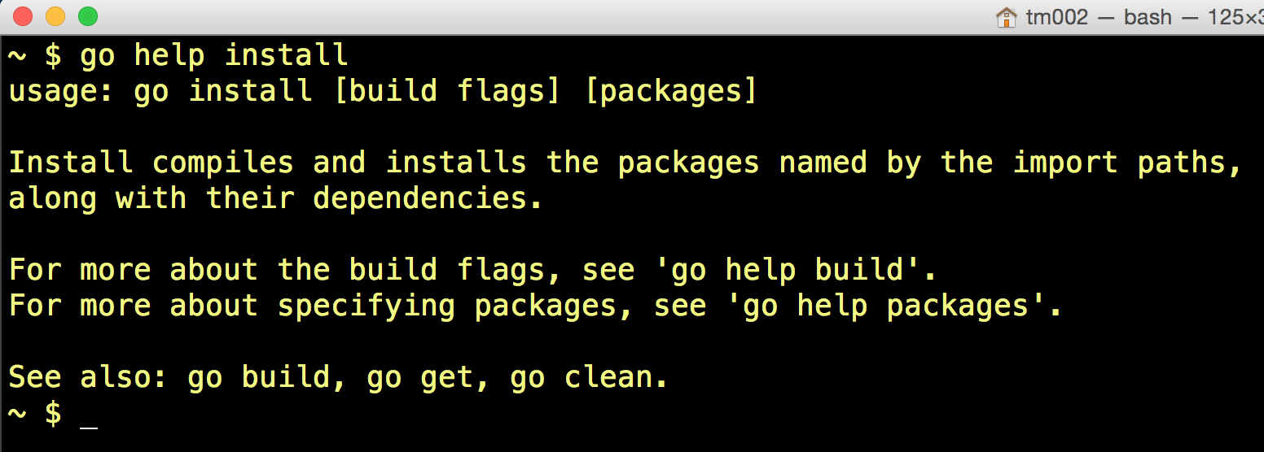

Slide 59
documentation

Slide 60
Review
Preview
getting help
go help
go help [command]
go help [topic]
go help examples:
go help env
variadic
...
BNF / EBNF
Backus Naur Form
Extended Backus Naur Form
go help packages
go help build
go help install
documentation
godoc.org
“imported by” example code
golang.org
godoc
google: golang godoc
golang.org/x/tools/cmd/godoc
godoc -src fmt Println
godoc -src fmt
godoc -http=:6060
godoc -html fmt
godoc -html fmt Println
godoc -q Reader
godoc -q Writer
godoc -q rand
close server
ctrl + c
http://go-search.org/
resources
An Introduction to Programming in Go
go by example
pluralsight trainings
youtube todd mcleod playlists
Golang.org
A Tour of Go
Golang Newsletter
learning golang from golang
https://golang.org/doc/install
https://golang.org/ref/spec
https://tour.golang.org/welcome/1
https://golang.org/doc/code.html
https://golang.org/doc/effective_go.html
https://blog.golang.org/

Slide 61
godoc.org
vs
golang.org
vs
godoc
what’s the difference?

Slide 62
godoc.org
documentation for packages written by anyone, including documentation for official SDK
godoc
documentation at TERMINAL for packages written by anyone, including documentation for official SDK
golang.org
documentation for official SDK only

Slide 63
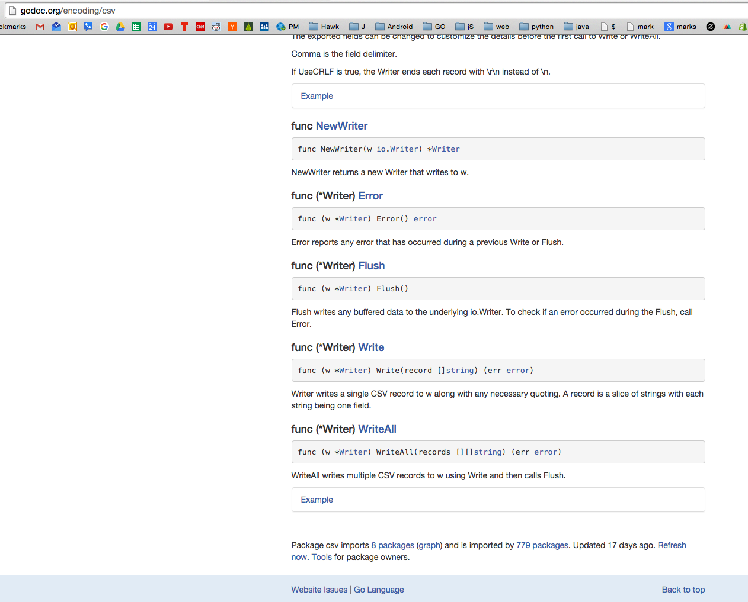
This is great, but be aware, both well-written and poorly-written code will be found.

Slide 64
documentation
godoc

Slide 65
Review
Preview
getting help
go help
go help [command]
go help [topic]
go help examples:
go help env
variadic
...
BNF / EBNF
Backus Naur Form
Extended Backus Naur Form
go help packages
go help build
go help install
documentation
godoc.org
“imported by” example code
golang.org
godoc
google: golang godoc
golang.org/x/tools/cmd/godoc
godoc -src fmt Println
godoc -src fmt
godoc -http=:6060
godoc -html fmt
godoc -html fmt Println
godoc -q Reader
godoc -q Writer
godoc -q rand
close server
ctrl + c
http://go-search.org/
resources
An Introduction to Programming in Go
go by example
pluralsight trainings
youtube todd mcleod playlists
Golang.org
A Tour of Go
Golang Newsletter
learning golang from golang
https://golang.org/doc/install
https://golang.org/ref/spec
https://tour.golang.org/welcome/1
https://golang.org/doc/code.html
https://golang.org/doc/effective_go.html
https://blog.golang.org/

Slide 66
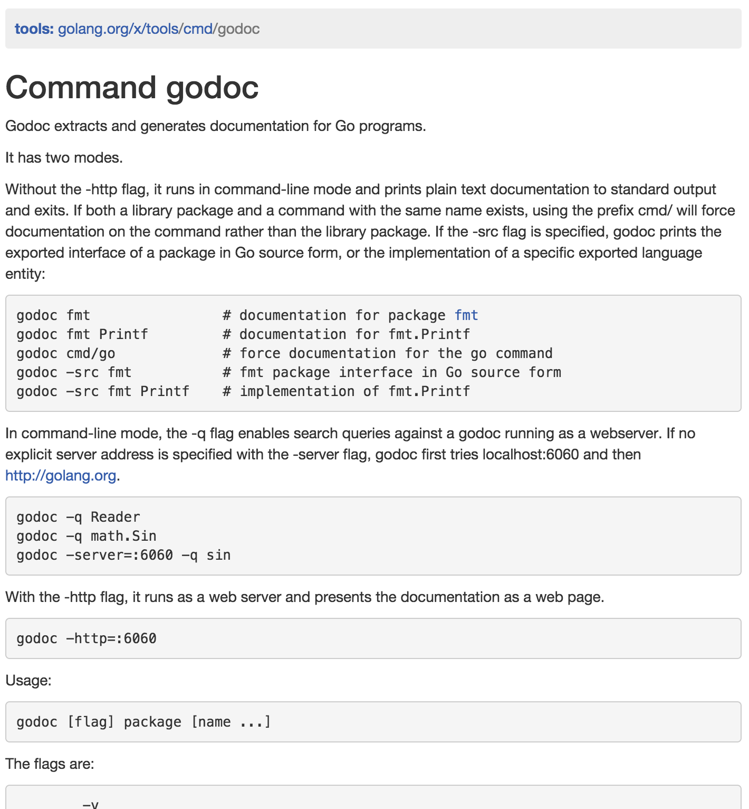
more about godoc
http://godoc.org/golang.org/x/tools/cmd/godoc
I found this by googling: golang godoc
Things sometimes migrate from tools to the standard SDK library
https://blog.golang.org/go1.5

Slide 67
exercise
can you find this at the terminal?

Slide 68
exercise
can you find this at the terminal?
I did not

Slide 69
exercise
just out of curiosity,
can you find more tools starting from this URL?
http://godoc.org/golang.org/x/tools/cmd/godoc

Slide 70
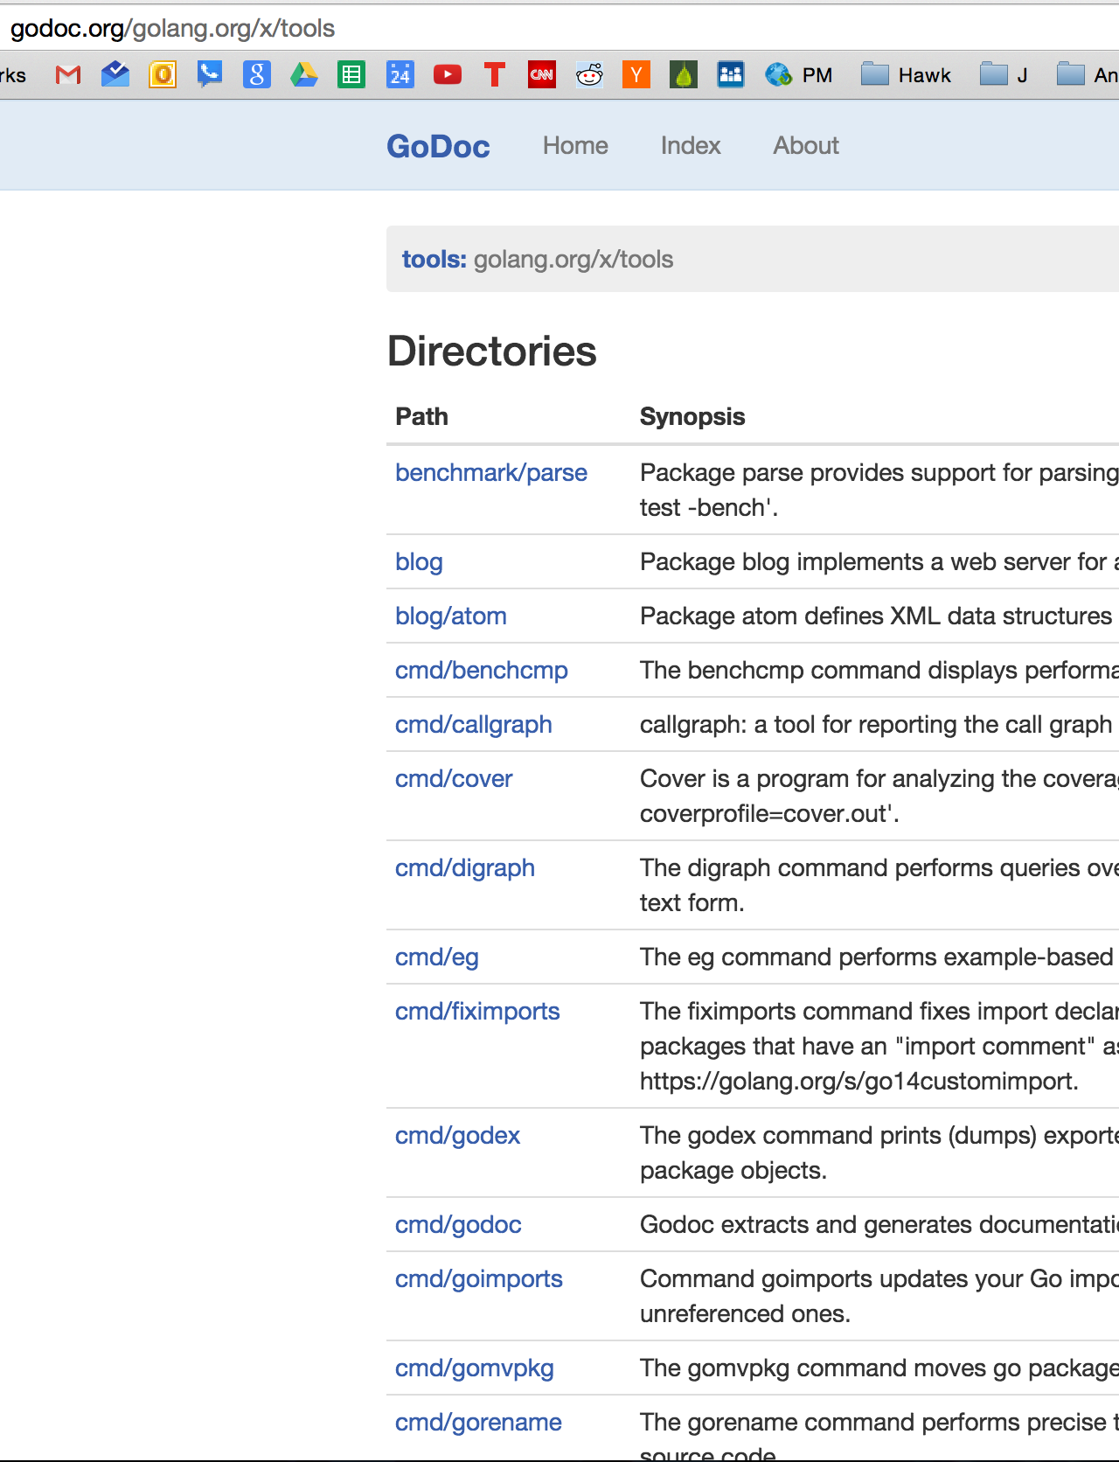
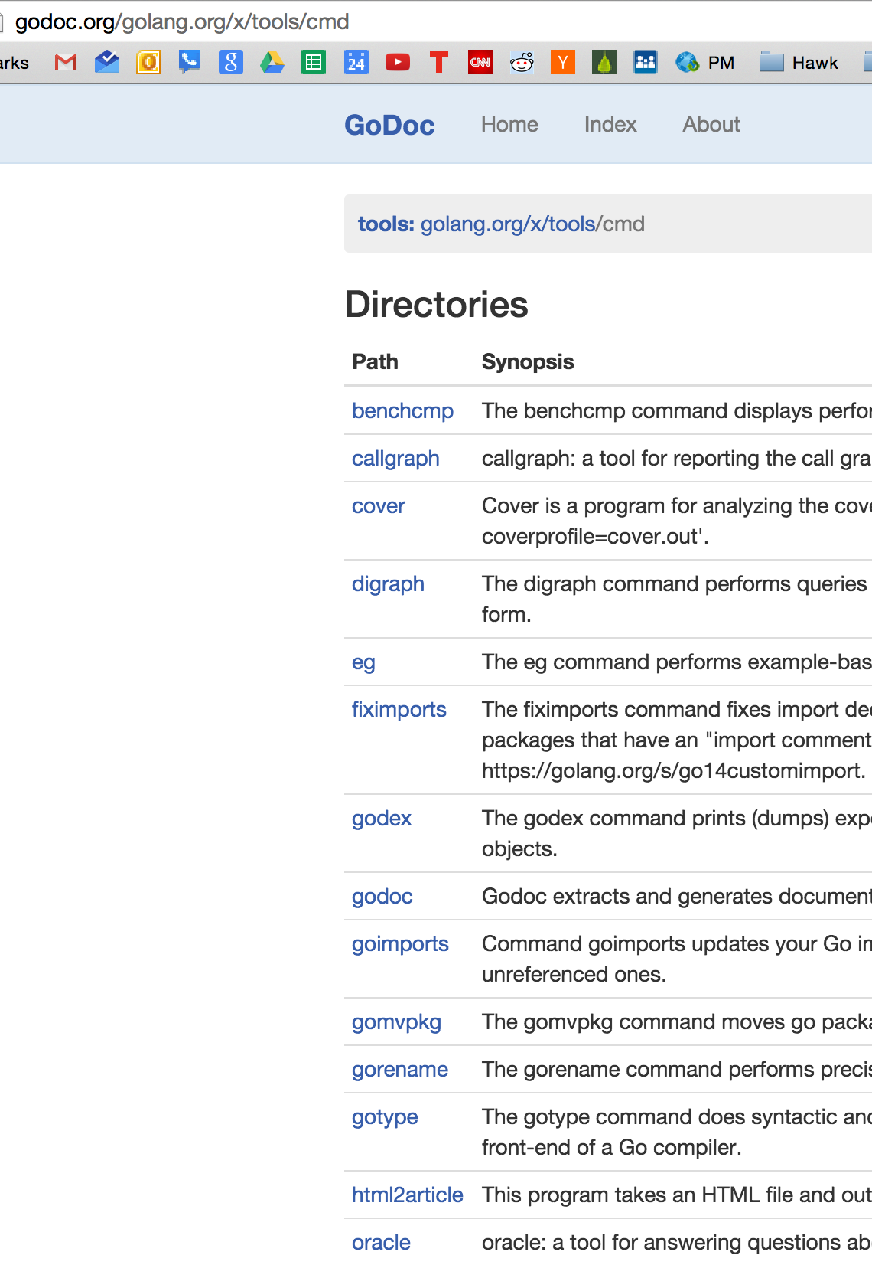

Slide 71
Review
Preview
getting help
go help
go help [command]
go help [topic]
go help examples:
go help env
variadic
...
BNF / EBNF
Backus Naur Form
Extended Backus Naur Form
go help packages
go help build
go help install
documentation
godoc.org
“imported by” example code
golang.org
godoc
google: golang godoc
golang.org/x/tools/cmd/godoc
godoc -src fmt Println
godoc -src fmt
godoc -http=:6060
godoc -html fmt
godoc -html fmt Println
godoc -q Reader
godoc -q Writer
godoc -q rand
close server
ctrl + c
http://go-search.org/
resources
An Introduction to Programming in Go
go by example
pluralsight trainings
youtube todd mcleod playlists
Golang.org
A Tour of Go
Golang Newsletter
learning golang from golang
https://golang.org/doc/install
https://golang.org/ref/spec
https://tour.golang.org/welcome/1
https://golang.org/doc/code.html
https://golang.org/doc/effective_go.html
https://blog.golang.org/

Slide 72
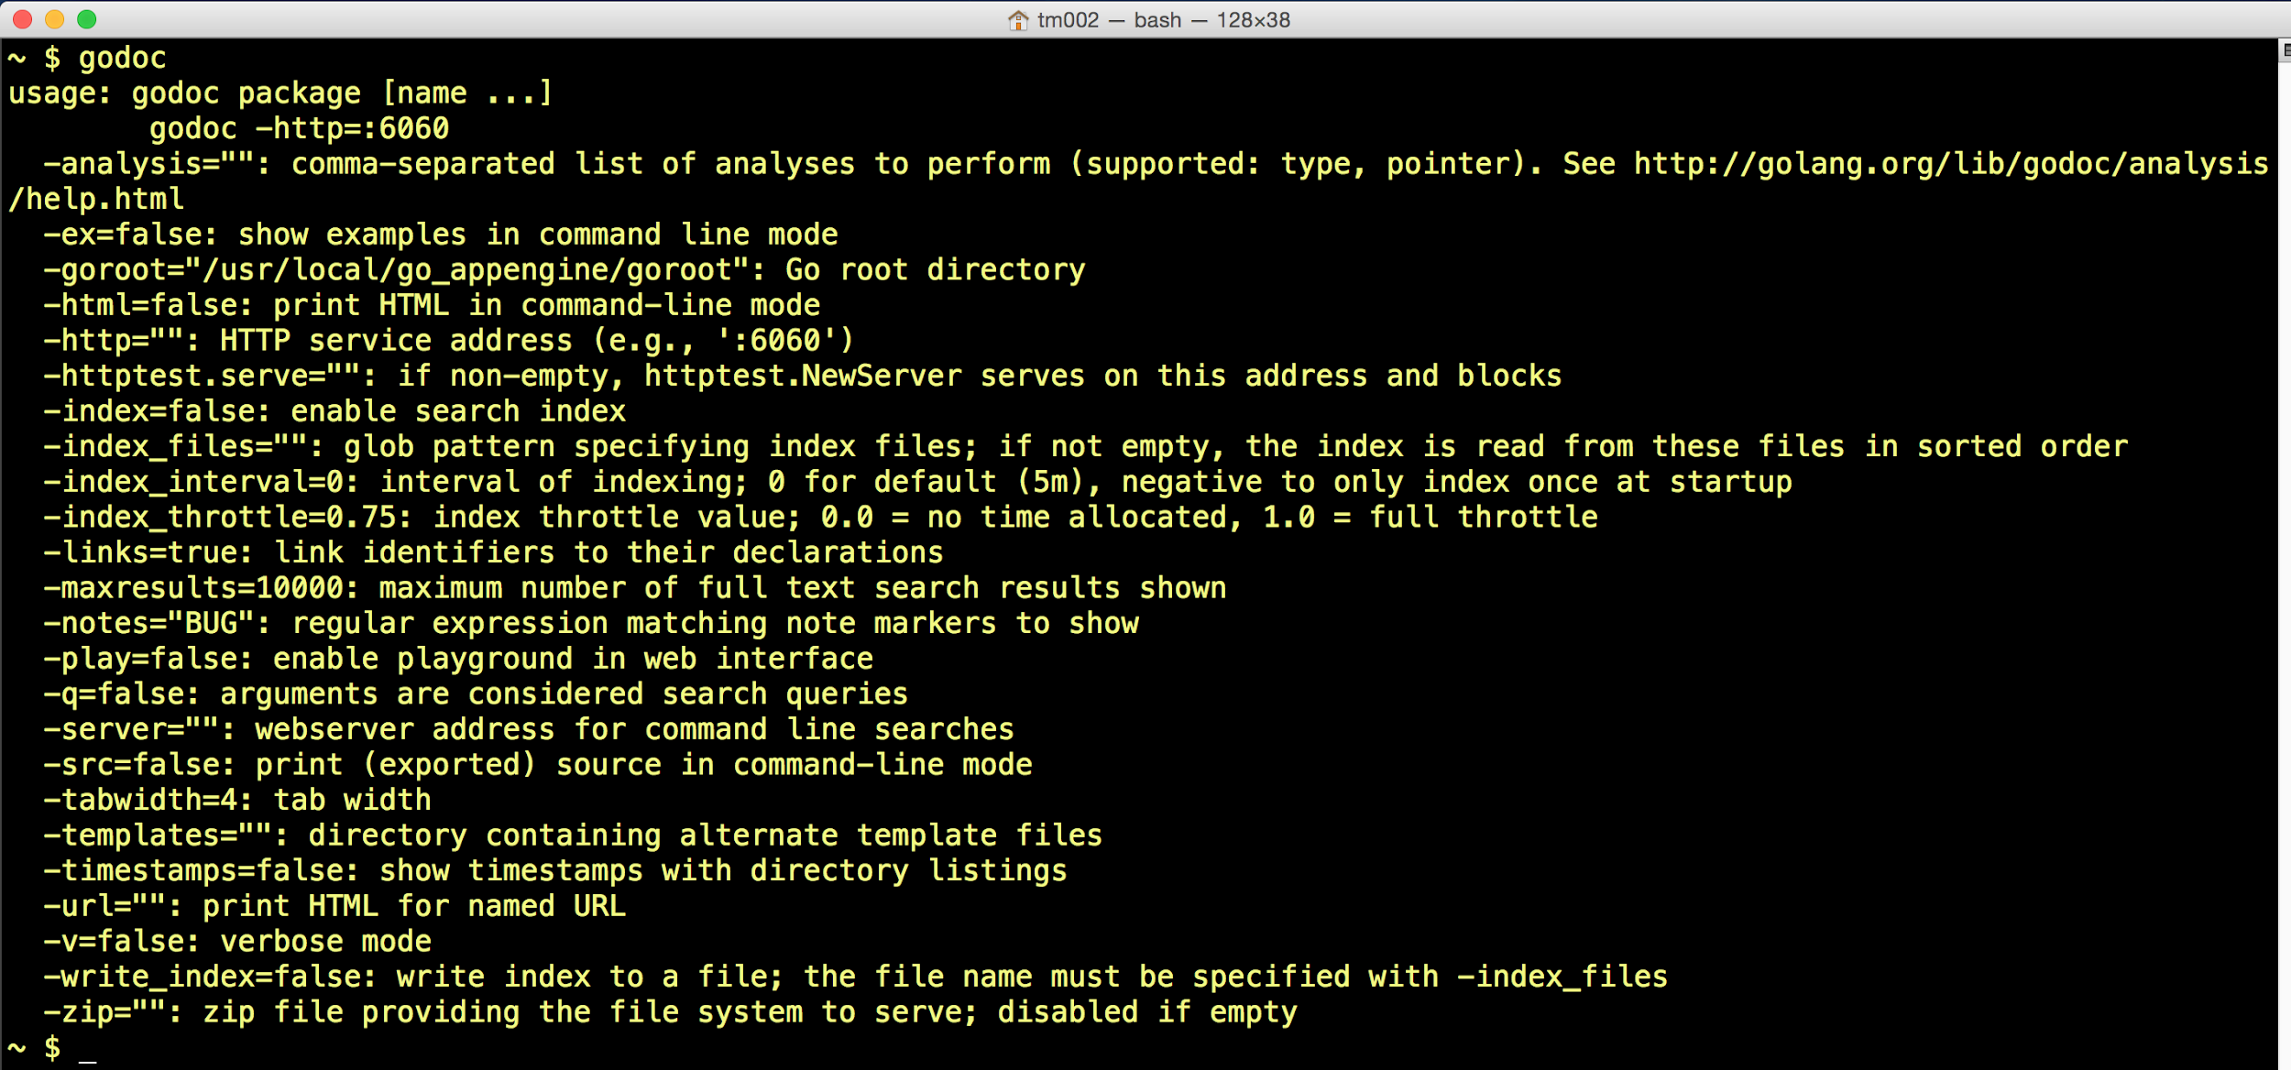

Slide 73
exercise
use “godoc package [name ...]”
with multiple names

Slide 74
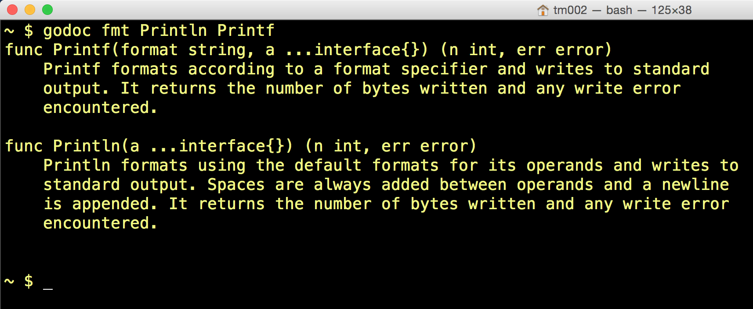

Slide 75
exercise
use “godoc package [name ...]”
with multiple names
What are the names: functions or methods?

Slide 76
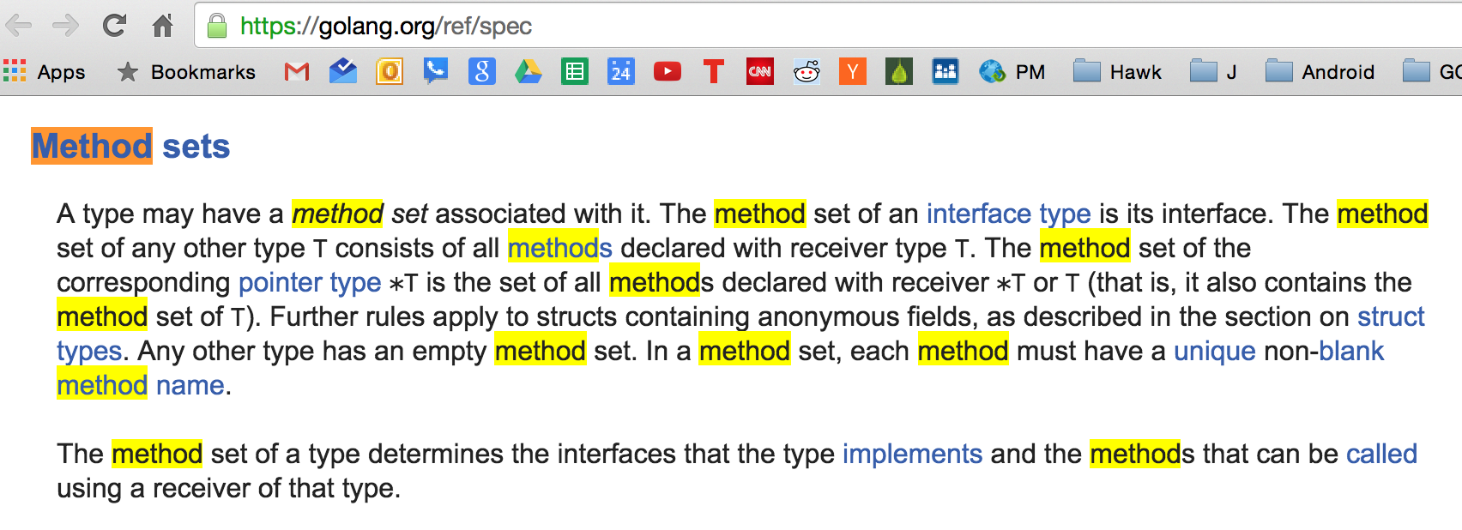
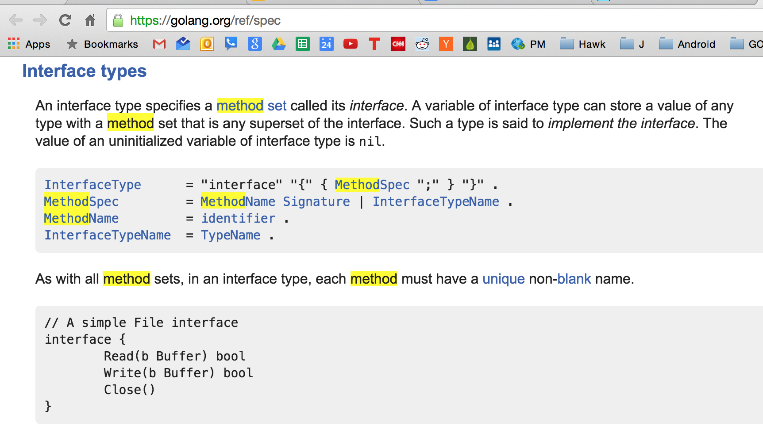
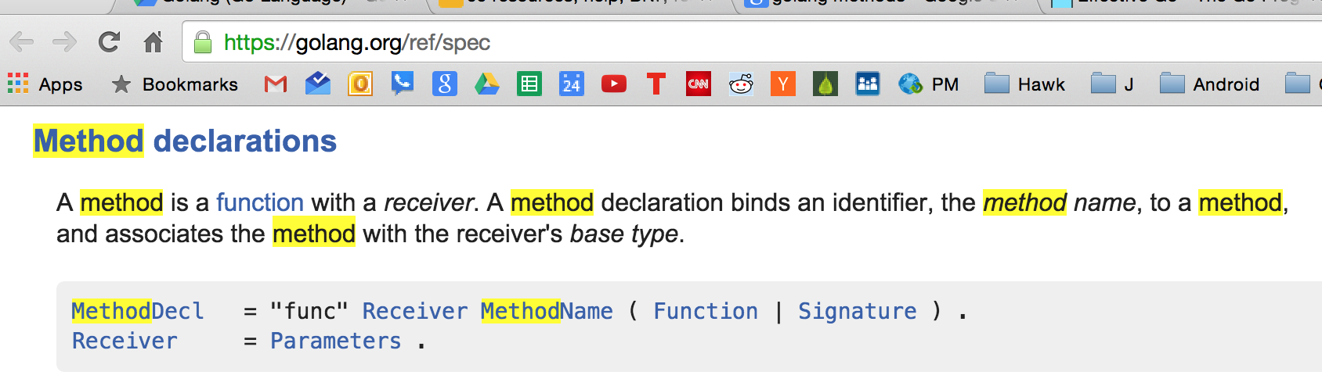
exercise
https://gobyexample.com/methods
http://golangtutorials.blogspot.com/2011/06/methods-on-structs.html
use “godoc package [name ...]”
with multiple names
What are the names: functions or methods?

Slide 77
exercise
use “go doc package [name ...]”
with one name

Slide 78
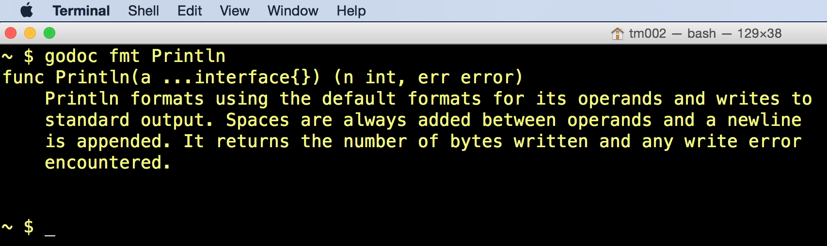

Slide 79
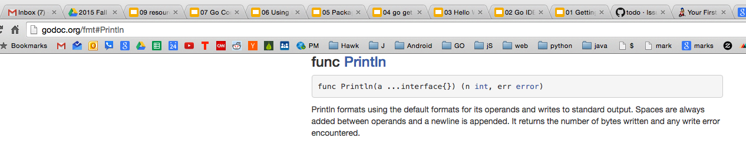
reminder: same as finding it at godoc.org (or golang.org)
but this gives us some code to look at:

Slide 80
Review
Preview
getting help
go help
go help [command]
go help [topic]
go help examples:
go help env
variadic
...
BNF / EBNF
Backus Naur Form
Extended Backus Naur Form
go help packages
go help build
go help install
documentation
godoc.org
“imported by” example code
golang.org
godoc
google: golang godoc
golang.org/x/tools/cmd/godoc
godoc -src fmt Println
godoc -src fmt
godoc -http=:6060
godoc -html fmt
godoc -html fmt Println
godoc -q Reader
godoc -q Writer
godoc -q rand
close server
ctrl + c
http://go-search.org/
resources
An Introduction to Programming in Go
go by example
pluralsight trainings
youtube todd mcleod playlists
Golang.org
A Tour of Go
Golang Newsletter
learning golang from golang
https://golang.org/doc/install
https://golang.org/ref/spec
https://tour.golang.org/welcome/1
https://golang.org/doc/code.html
https://golang.org/doc/effective_go.html
https://blog.golang.org/

Slide 81
exercise
use “godoc [flag] package [name ...]” with a flag
to show you at the terminal an example of the code used for
fmt Println

Slide 82
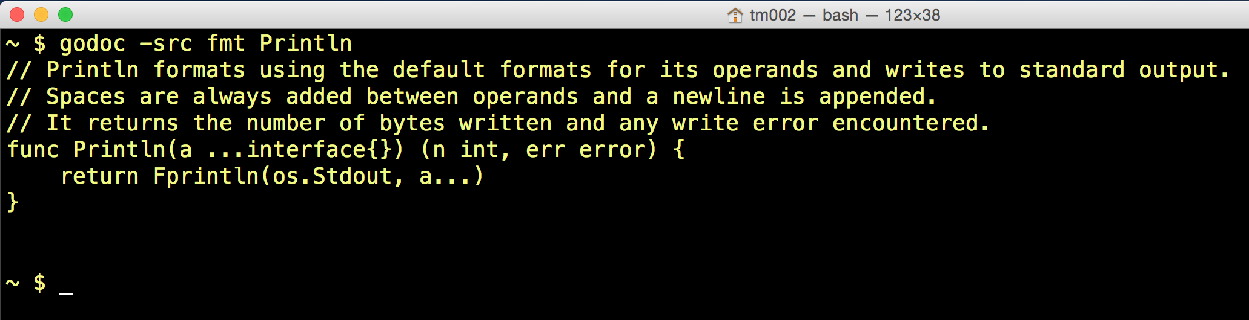

Slide 83
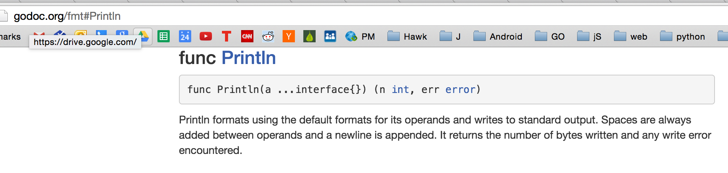
godoc vs godoc.org

Slide 84
Review
Preview
getting help
go help
go help [command]
go help [topic]
go help examples:
go help env
variadic
...
BNF / EBNF
Backus Naur Form
Extended Backus Naur Form
go help packages
go help build
go help install
documentation
godoc.org
“imported by” example code
golang.org
godoc
google: golang godoc
golang.org/x/tools/cmd/godoc
godoc -src fmt Println
godoc -src fmt
godoc -http=:6060
godoc -html fmt
godoc -html fmt Println
godoc -q Reader
godoc -q Writer
godoc -q rand
close server
ctrl + c
http://go-search.org/
resources
An Introduction to Programming in Go
go by example
pluralsight trainings
youtube todd mcleod playlists
Golang.org
A Tour of Go
Golang Newsletter
learning golang from golang
https://golang.org/doc/install
https://golang.org/ref/spec
https://tour.golang.org/welcome/1
https://golang.org/doc/code.html
https://golang.org/doc/effective_go.html
https://blog.golang.org/

Slide 85
exercise
use “godoc [flag] package [name ...]”
to show you at the terminal the package
fmt

Slide 86
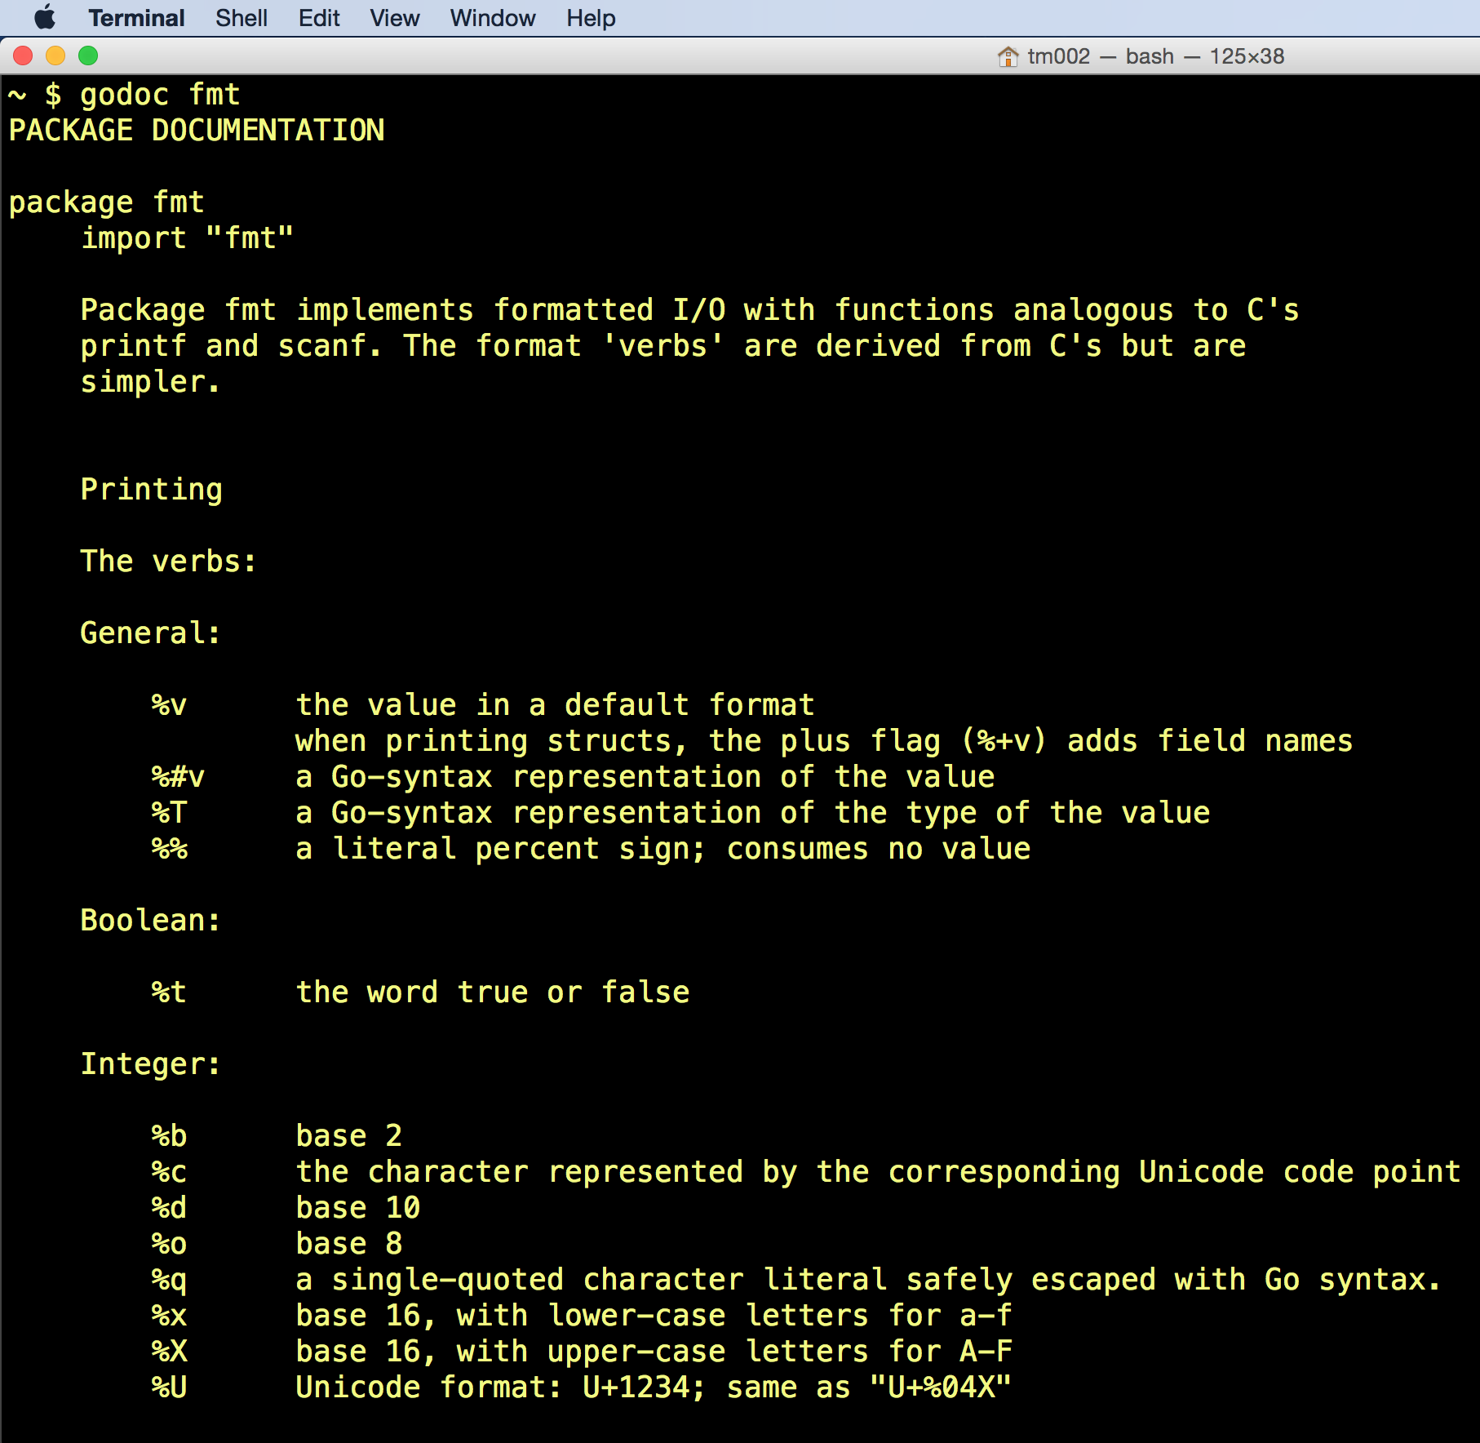
You don’t need to specify method names because names [ name …] are optional

Slide 87
exercise
find on godoc.org
the package
fmt

Slide 88
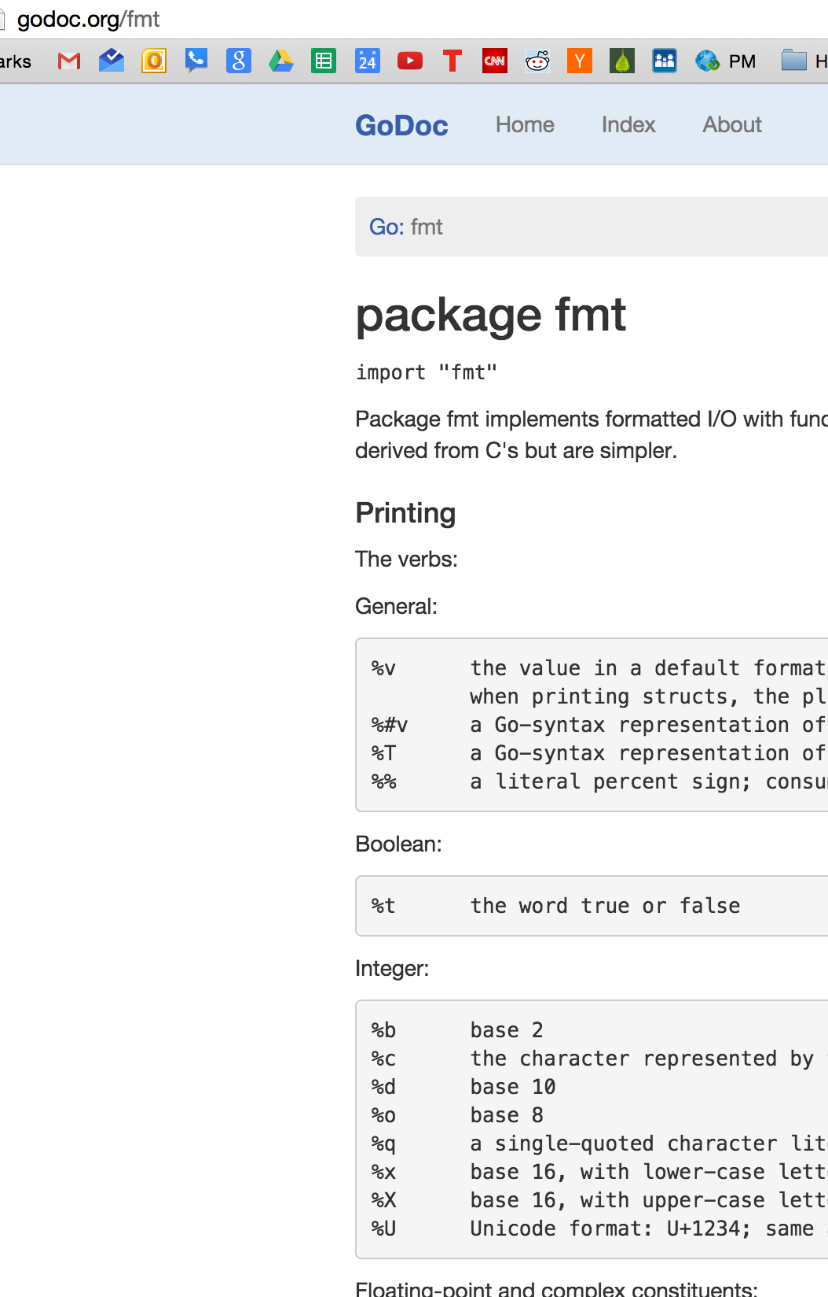
get the same thing at the terminal
as you get at godoc.org

Slide 89
Review
Preview
getting help
go help
go help [command]
go help [topic]
go help examples:
go help env
variadic
...
BNF / EBNF
Backus Naur Form
Extended Backus Naur Form
go help packages
go help build
go help install
documentation
godoc.org
“imported by” example code
golang.org
godoc
google: golang godoc
golang.org/x/tools/cmd/godoc
godoc -src fmt Println
godoc -src fmt
godoc -http=:6060
godoc -html fmt
godoc -html fmt Println
godoc -q Reader
godoc -q Writer
godoc -q rand
close server
ctrl + c
http://go-search.org/
resources
An Introduction to Programming in Go
go by example
pluralsight trainings
youtube todd mcleod playlists
Golang.org
A Tour of Go
Golang Newsletter
learning golang from golang
https://golang.org/doc/install
https://golang.org/ref/spec
https://tour.golang.org/welcome/1
https://golang.org/doc/code.html
https://golang.org/doc/effective_go.html
https://blog.golang.org/

Slide 90
exercise
use “godoc [flag] package [name ...]” with a flag
then lookup fmt package documentation in a browser at localhost:6060

Slide 91
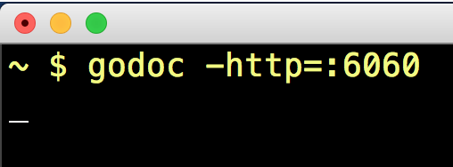
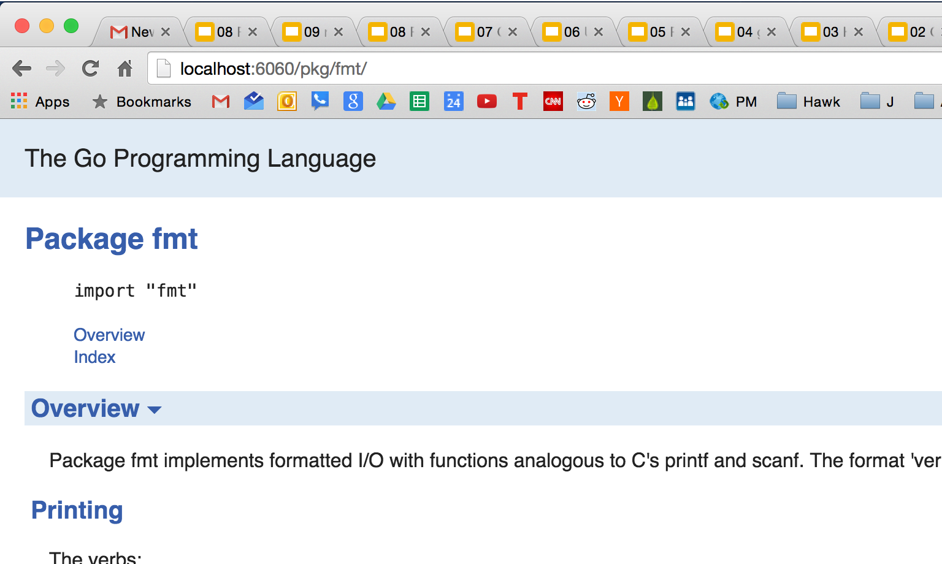

Slide 92
close server
at terminal: ctrl + c

Slide 93
Review
Preview
getting help
go help
go help [command]
go help [topic]
go help examples:
go help env
variadic
...
BNF / EBNF
Backus Naur Form
Extended Backus Naur Form
go help packages
go help build
go help install
documentation
godoc.org
“imported by” example code
golang.org
godoc
google: golang godoc
golang.org/x/tools/cmd/godoc
godoc -src fmt Println
godoc -src fmt
godoc -http=:6060
godoc -html fmt
godoc -html fmt Println
godoc -q Reader
godoc -q Writer
godoc -q rand
close server
ctrl + c
http://go-search.org/
resources
An Introduction to Programming in Go
go by example
pluralsight trainings
youtube todd mcleod playlists
Golang.org
A Tour of Go
Golang Newsletter
learning golang from golang
https://golang.org/doc/install
https://golang.org/ref/spec
https://tour.golang.org/welcome/1
https://golang.org/doc/code.html
https://golang.org/doc/effective_go.html
https://blog.golang.org/

Slide 94
exercise
use “godoc [flag] package [name ...]” with a flag
to print html for the fmt package in the terminal

Slide 95
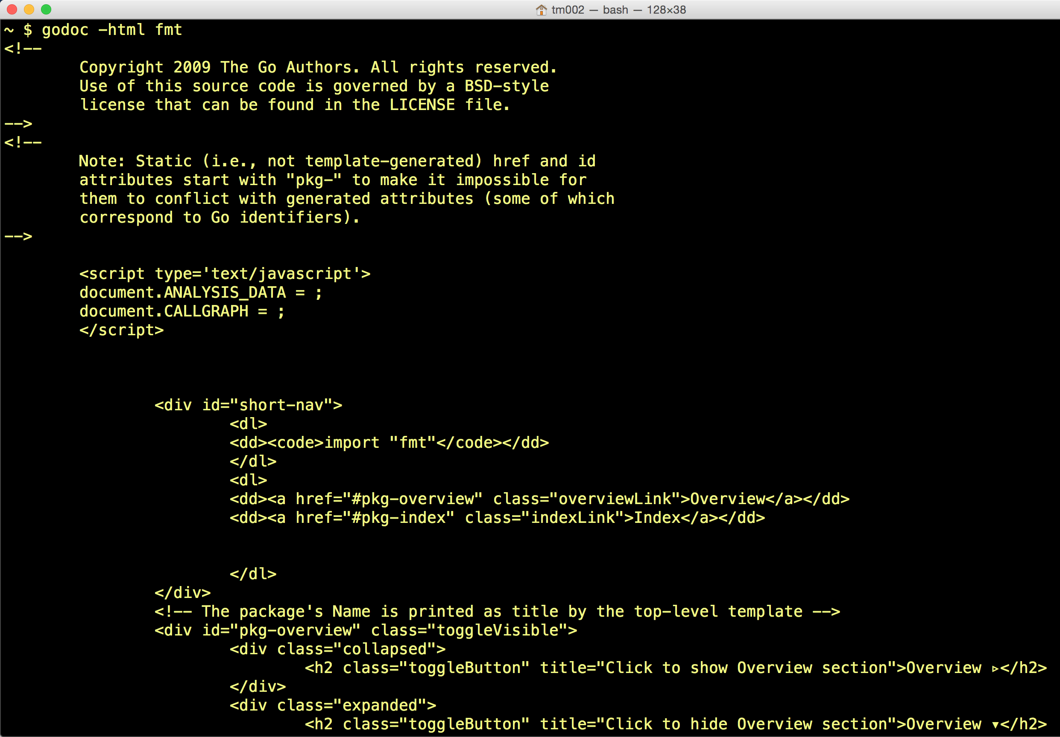

Slide 96
exercise
use “godoc [flag] package [name ...]” with a flag
to print html for the fmt Println method in the terminal

Slide 97
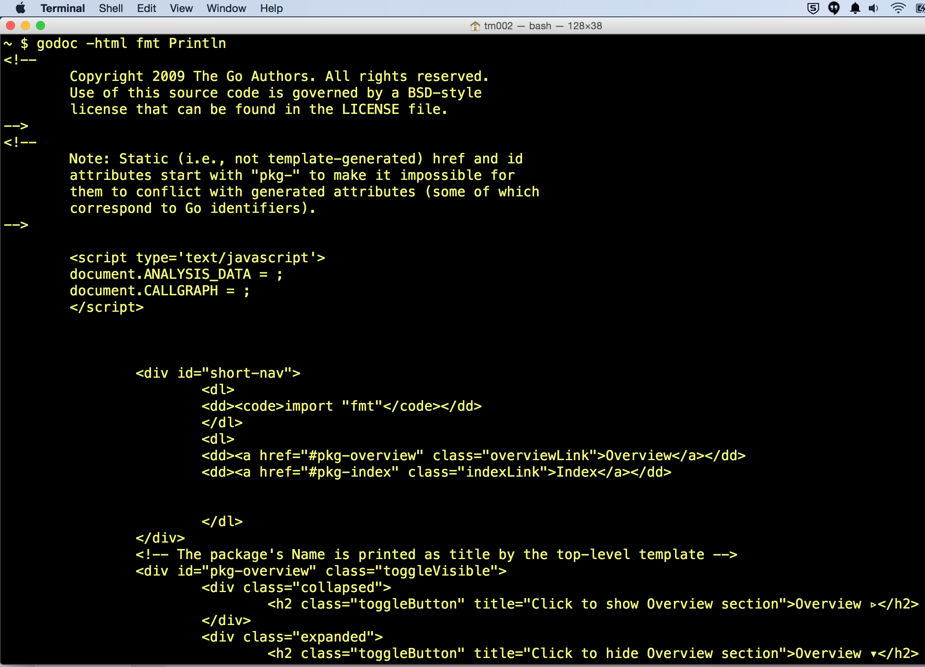

Slide 98
exercise
use “godoc [flag] package [name ...]” with a flag
to find every “Reader” in the documentation

Slide 99
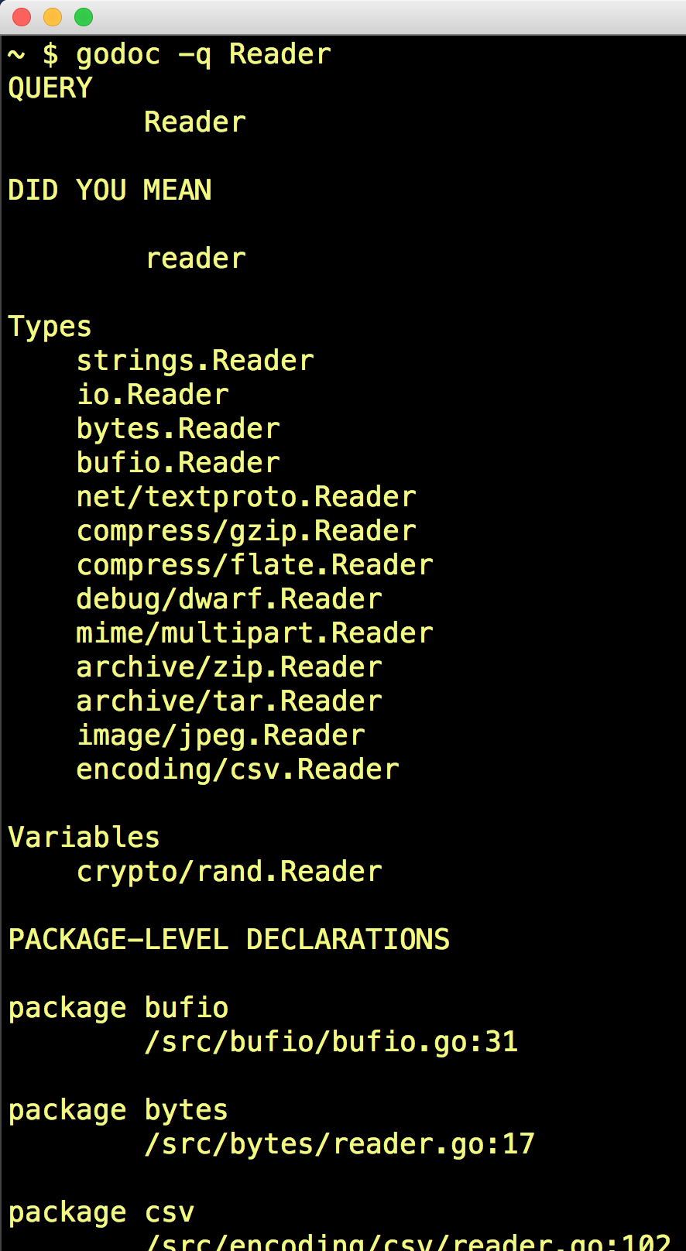

Slide 100
exercise
use “godoc [flag] package [name ...]” with a flag
to find every “Writer” in the documentation

Slide 101
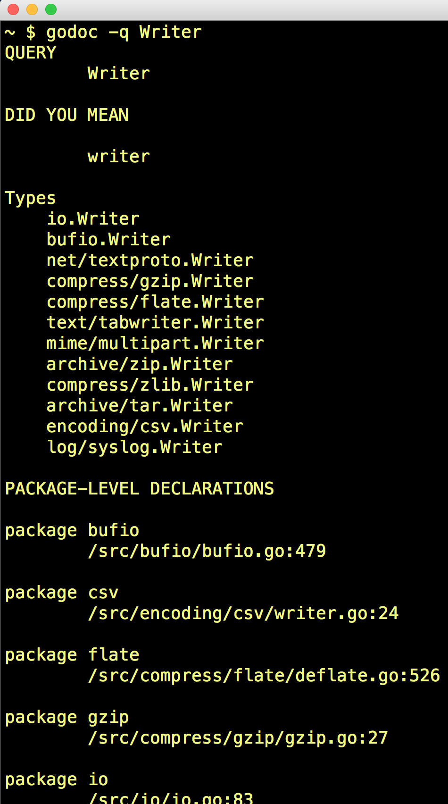

Slide 102
exercise
use “godoc [flag] package [name ...]” with a flag
to find package that gives a random number
(search for “rand”)

Slide 103
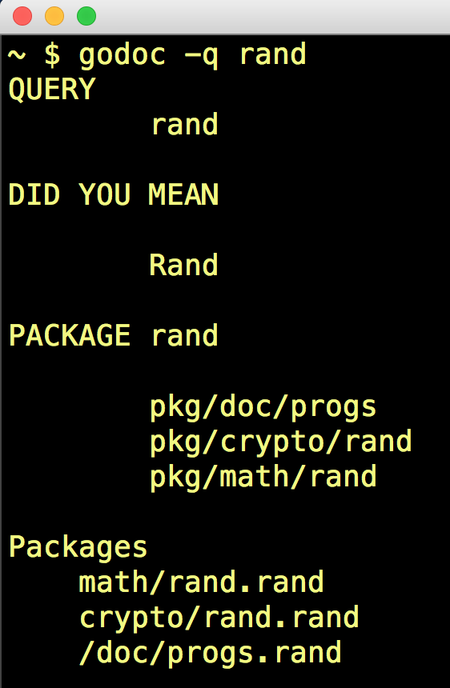

Slide 104
webstorm cmd + click
reminder:
cmd+click in webstorm
allows you to click on a package / method
to view the source code of that package / method

Slide 105

If I hold down “cmd” and click fmt ...

Slide 106

I am taken to the source code!

Slide 107
Do you know the answer to this question now?
What’s the difference between
godoc.org
golang.org
godoc at terminal
go help [command]
go help [topic]

Slide 108
Review
getting help
go help
go help [command]
go help [topic]
go help examples:
go help env
variadic
...
BNF / EBNF
Backus Naur Form
Extended Backus Naur Form
go help packages
go help build
go help install
documentation
godoc.org
“imported by” example code
golang.org
godoc
google: golang godoc
golang.org/x/tools/cmd/godoc
godoc -src fmt Println
godoc -src fmt
godoc -http=:6060
godoc -html fmt
godoc -html fmt Println
godoc -q Reader
godoc -q Writer
godoc -q rand
close server
ctrl + c
http://go-search.org/
resources
An Introduction to Programming in Go
Bootcamp training
go by example
pluralsight trainings
youtube todd mcleod playlists
Golang.org
A Tour of Go
Golang Newsletter
Some other training I’ve yet to take
learning golang from golang.org
https://golang.org/doc/install
https://golang.org/ref/spec
https://tour.golang.org/welcome/1
https://golang.org/doc/code.html
https://golang.org/doc/effective_go.html
https://blog.golang.org/

Slide 109
Review Questions

Slide 110
variadic
Define variadic.
What is the difference between code like this:
And like this:

Slide 111
BNF
Define BNF

Slide 112
EBNF
Create your own example using EBNF

Slide 113
godoc
Launch a server showing docs at localhost

Slide 114
godoc
Using the terminal, find every “Reader” in the documentation

